Slide 1
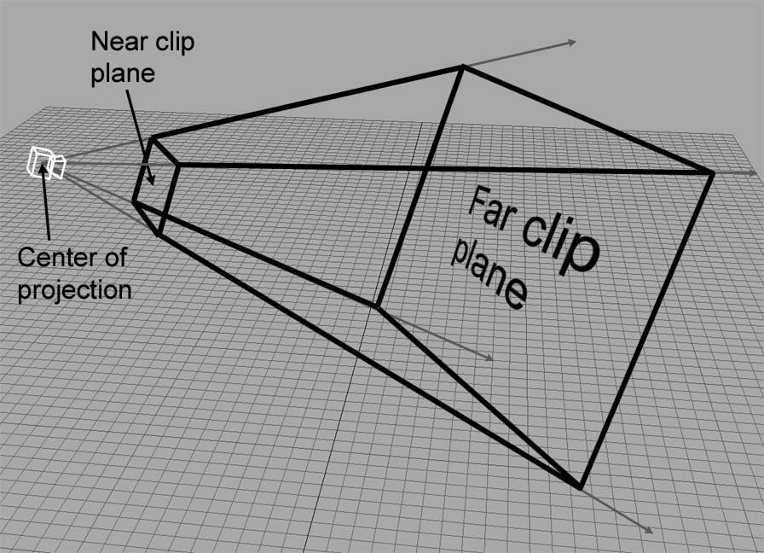
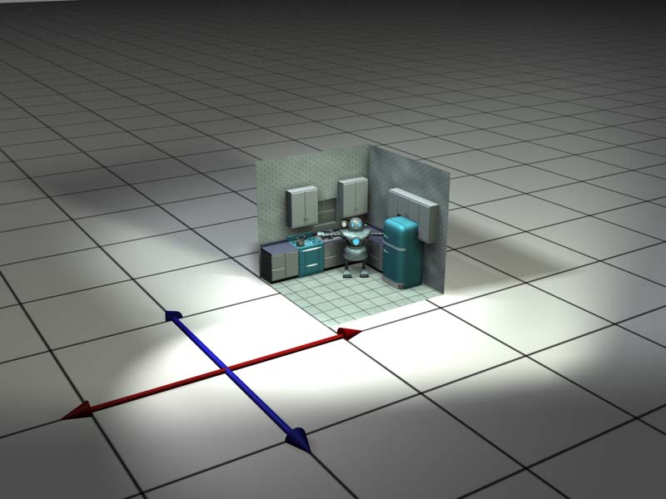
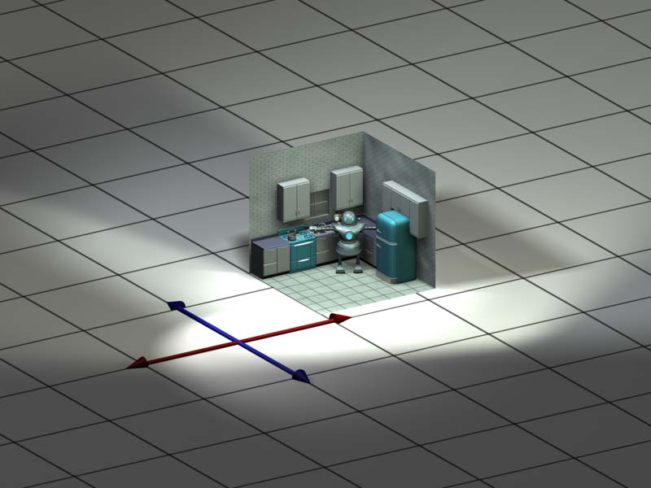
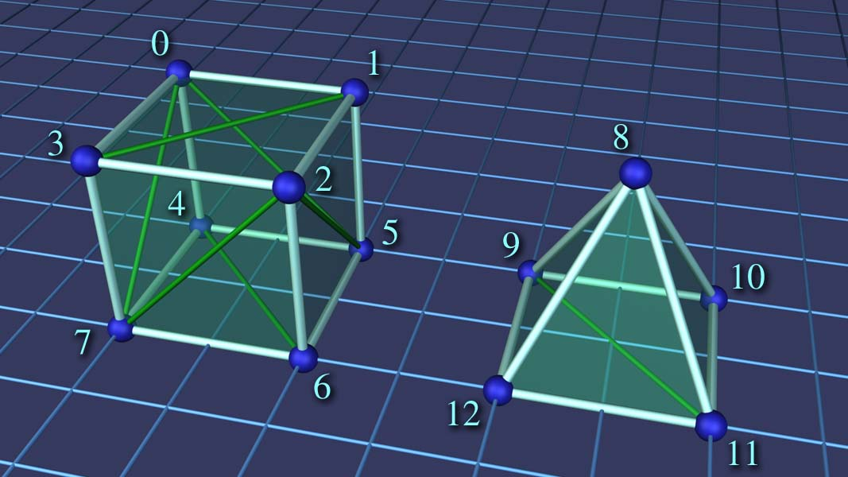
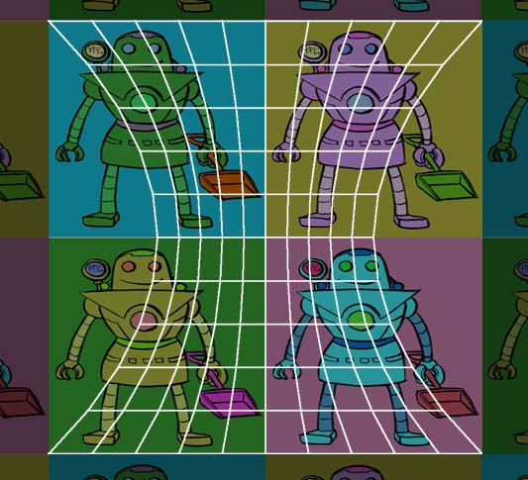
Chapter 10: Mathematical Topics from 3D Graphics
Fletcher Dunn
Valve Software
Ian Parberry
University of North Texas
3D Math Primer for Graphics & Game Development

Slide 2
What You’ll See in This Chapter
This chapter discusses a number of mathematical issues that arise when creating 3D graphics on a computer. It is divided into eleven sections.
Section 10.1 discusses the rendering equation.
Section 10.2 introduces the math of viewing in 3D.
Section 10.3 reviews coordinate spaces and transforms.
Section 10.4 looks at representing geometry.
Section 10.5 is about material properties.
Section 10.6 discusses the standard lighting model.
Section 10.7 looks at some common light sources.
Section 10.8 examines skeletal animation.
Section 10.9 introduces bump mapping.
Section 10.10 is on the graphics pipeline.
Section 10.11 gives some examples of pixel and vertex shaders that implement some of the techniques covered in this chapter.

Slide 3
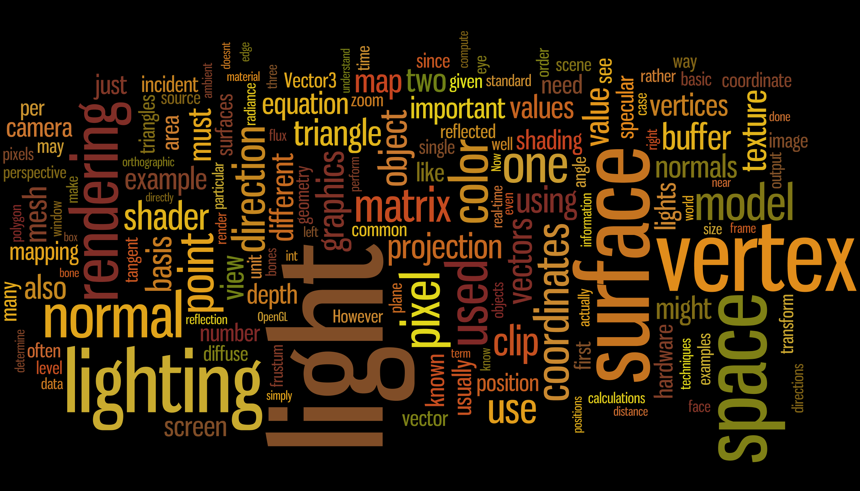
Word Cloud

Slide 4
Section 10.1: How Graphics Works

Slide 5
The Rendering Equation
Rendering answers the question: “For each pixel on the screen, what is its color?”
That is, “What color of light is approaching the camera from the direction corresponding to this pixel?”
There are two cases to consider.
Either we are looking directly at a light source, and light traveled directly from it to our eye, or (more commonly)
Light departed from a light source in some other direction, bounced one or more times, and then entered our eye.
The rendering algorithm also consists of two steps:
Visible surface determination. Find the surface that is closest to the eye in the direction corresponding to the current pixel.
Lighting. Determine what light is emitted and/or reflected off of this surface in the direction of the eye.

Slide 6
Visible Surface Determination
There are 2 common solutions to this problem.
Ray tracing: Follow light rays backwards.
Depth buffering: Also known as Z-buffering.
More next…

Slide 7
Ray Tracing
Rather than following light rays in the direction that they travel from the emissive surfaces, we trace the rays backwards, so that we can deal only with the light rays that matter: the ones that enter our eye from the given direction.
We send a ray out from the eye in the direction through the center of each pixel to see the first object in the scene this ray strikes.
Then we compute the color that is being emitted/reflected from that surface back in the direction of the ray.

Slide 8
Depth Buffer
Depth buffer is a solution to the occlusion problem: figuring which triangles are in front of which.
Depth buffer has the same resolution as the screen.
For each pixel [ x y ], the corresponding depth buffer entry Z[x][ y] stores the depth of the pixel.
Usually the z coordinate in clip space is used – hence the name z-buffer.

Slide 9
Depth Buffer Usage
At the start of each frame, initialize the depth buffer to some far distance (in clip space this is 1.0).
Each time a pixel [ x y z w ] from clip space is to be drawn, only draw it if z < Z[x][y]; if this happens, then set Z[x][y] = z.
Depth buffers come in different resolutions – for example 8-bit or 16-bit.

Slide 10
Forward and Deferred Rendering
At this point we might also proceed to step 2 of the rendering algorithm (at least for this pixel) and update the frame buffer with the color of the light being emitted or reflected from the surface that point. This is known as forward rendering.
Deferred rendering is an old technique that is becoming popular again due to the current location of bottlenecks in the types of images we are producing and the hardware we are using to produce them.
A deferred renderer uses, in addition to the frame buffer and the depth buffer, additional buffers, collectively known as the G-buffer (short for geometry buffer), which holds extra information about the surface closest to the eye at that location.
Compared to a forward renderer, a deferred renderer follows our two step rendering algorithm a bit more literally.
First we render the scene into the G-buffer, essentially performing only visibility determination, fetching the material properties of the point that is seen by each pixel, but not yet performing lighting calculations.
Now the geometry of the scene can be discarded, since we have everything we need to perform the lighting calculations and fill in the color values in the frame buffer.

Slide 11
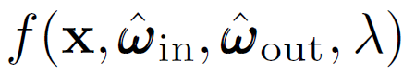
Lighting
What Color is That Object?
It depends on the color of the reflected light.
More exactly, it depends on the frequency distribution of the reflected light.
It is called the bidirectional reflectance distribution function, or BRDF for short, given by:

Slide 12



BRDF
The value of this function tells what fraction of the light incident at the point x from direction is reflected in the outgoing direction
As indicated by the boldface and hat, ^! might be a unit vector, but more generally it can be any way of specifying a direction; polar angles might be another choice.
Different colors of light are usually reflected differently, hence the dependence on λ, which is the color (actually, the wavelength — more on this in a moment) of the light.

Slide 13



Example: A Green Ball
A green object is green and not blue because it reflects incident light that is green more strongly than that of any other color.
Perhaps 95% of the blue light is absorbed, and only 5% reflected in various directions.
White light is actually a combination of all the different colors of light, so a green object essentially filters out colors other than green.
If a different object reflected green light in the same way as this ball, but 50% of the blue light were absorbed and 50% reflected, we might perceive the object as teal.
Or if most of the light was absorbed, except for a small amount of green light, then we would perceive it as a darker shade of green.

Slide 14


BSSDF
Next, consider the difference between shiny red plastic and diffuse red construction paper.
A shiny surface reflects incident light much more strongly in one particular direction compared to others, whereas a diffuse surface scatters light more evenly across all outgoing directions.
A perfect reflector would reflect all the light from one incoming direction in a single outgoing direction, whereas a perfectly diffuse surface would reflect light equally in all outgoing directions, regardless of the direction of incidence.
More complicated phenomena can be expressed by generalizing the BRDF slightly.
Translucence and light refraction can be easily incorporated, simply by allowing the direction vectors to point back into the surface.
We might call this mathematical generalization a bidirectional surface scattering distribution function (BSSDF).
Even volumetric effects such as fog and subsurface scattering can be expressed by dropping the word “surface” and defining a BSDF at any point in space.
Taken at face value, these are obviously impractical theoretical tools, but they can be useful in understanding how to design practical ones.

Slide 15
The Normalization Constraint and Helmholtz Reciprocity
There are criteria that a BRDF must satisfy in order to be physically plausible. For example, it doesn’t make sense for a negative amount of light to be reflected in any direction.
Also, it’s not possible for more light to be reflected than is incident, although the surface may absorb some energy so less light may be reflected than is incident. This is usually called the normalization constraint.
A less obvious principle obeyed by physical surfaces is Helmholtz reciprocity: if we pick two arbitrary directions, the same fraction of light should be reflected, no matter which is the incident direction and which is the outgoing direction. In other words,
In some books and papers you may see BRDF’s where the two directions are not labeled as “in” and “out”, assuming Helmholtz reciprocity.

Slide 16
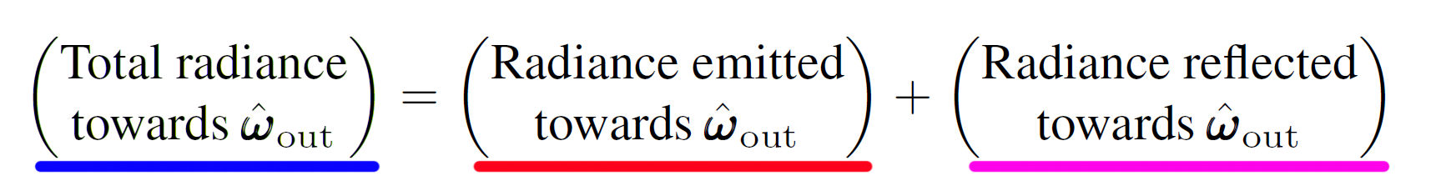
The Lighting Equation
More detail on the next slide…

Slide 17
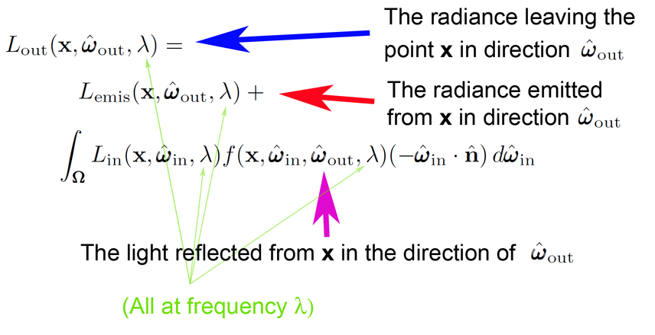
The Lighting Equation

Slide 18
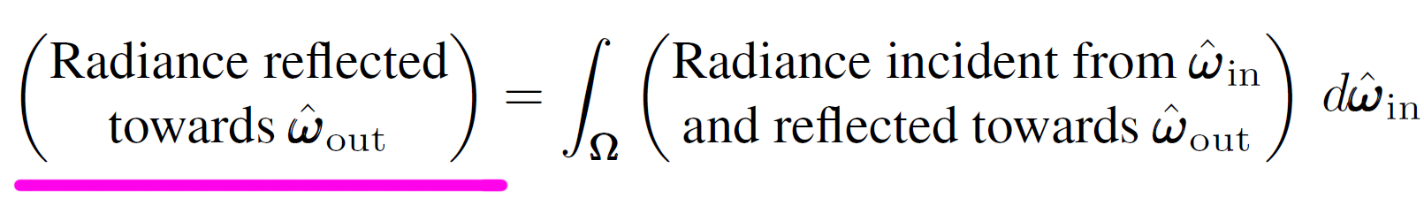


More on the Tricky Integral
Symbol Ω appears where we normally would write the limits of integration. This is intended to mean “sum over the hemisphere of possible incoming directions.”
For each incoming direction , we determine how much radiance was incident in this incoming direction and got scattered in the outgoing direction
The sum of all these contributions from all the different incident directions gives the total radiance reflected in the direction
In the real (continuous) world this is an integral.
In the virtual (discrete) world, this will be a summation.

Slide 19
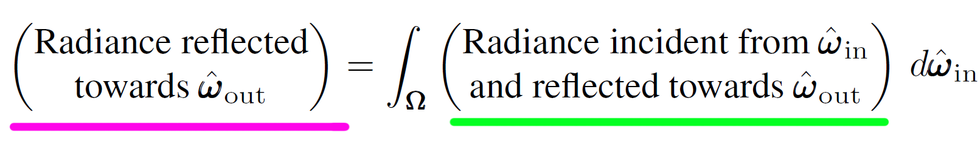
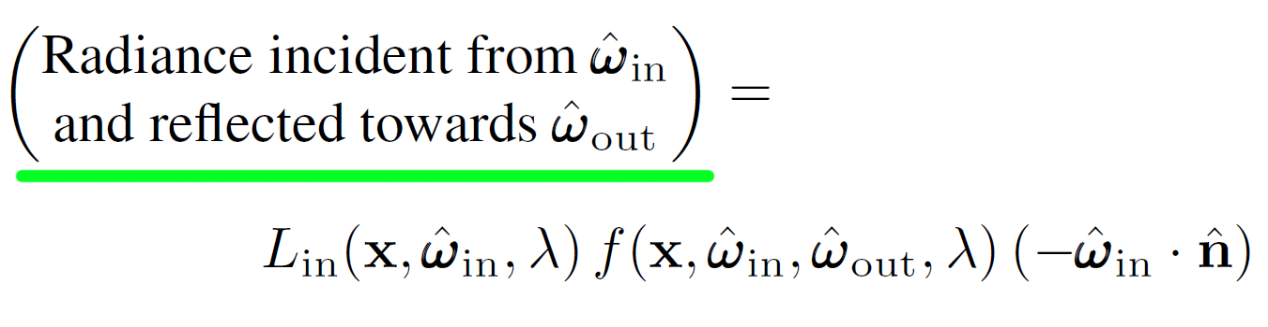
More on the Tricky Integral

Slide 20
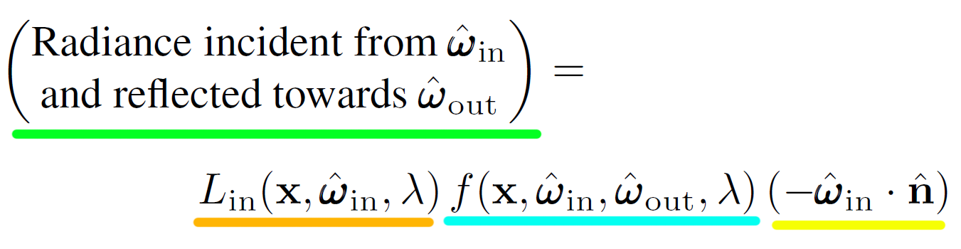

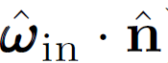
More on the Tricky Integral
The first term denotes the radiance incident from the direction of
The next term is simply the BRDF, which tells us how much of the radiance incident from this particular direction will be reflected in the outgoing direction we care about.
Finally, we have the Lambert term, which accounts for the fact that more incident light is available to be reflected, per unit surface area, when is perpendicular to the surface than when at a glancing angle to the surface.
The vector is the outward facing surface normal, and the dot product peaks at 1 in the perpendicular direction, and trails off to zero as the angle of incidence becomes more glancing. More about this term later.

Slide 21
Rendering as an Integral Equation
The difficulty of rendering comes from the fact the rendering equation is an integral equation: it states a relationship between some unknown function L_{out} the distribution of light on the surfaces in the scene, in terms of its own integral.
It might not be apparent that the rendering equation is recursive, but L_{out} actually appears on both sides of the ‘=’.
It appears in the evaluation of L_{in}, which is precisely the expression we set out to solve for each pixel: What is the radiance incident on a point, from a given direction?
Thus to find the radiance exiting a point x, we need to know all the radiance incident at x from all directions.
But the radiance incident on x is the same as the radiance leaving from all other surfaces visible to x, in the direction pointing from the other surface towards x.

Slide 22
Rendering as an Approximation
To render a scene realistically, we must solve the rendering equation, which requires us to know (in theory) not only the radiance arriving at the camera, but the entire distribution of radiance in the scene in every direction at every point.
Clearly this is too much to ask for a finite, digital computer, since both the set of surface locations and the set of potential incident and exiting directions are infinite.
The real art in creating software for digital image synthesis is to allocate the limited processor time and memory most efficiently, in order to make the best possible approximation.

Slide 23
Global Illumination
The basic lighting model that we will learn only accounts for direct light.
It doesn’t account for indirect light that bounced off of one surface and arrived at another.
In other words, it only does one level of recursion in the rendering equation.
A huge component of realistic images is accounting for the indirect light; that is, to more fully solve the rendering equation.
The various methods for accomplishing this are known as global illumination techniques.

Slide 24
Section 10.2: Viewing in 3D

Slide 25
Specifying the Output Window
We don’t have to render to the entire screen.
For example, in split-screen multiplayer games, each player is given a portion of the screen.
Can render to a file or to a texture.
The output window is the portion of the output device where our image will be rendered.

Slide 26
Screen Coordinates
Recall that coordinates start with (0, 0) at the top-left of the screen, +y goes down, +x goes across.
(winPos_{x}, winPos_{y}) is the top left corner of the output screen in screen coordinates.
devRes_{x} and devRes_{y} are the dimensions of the device in pixels.
winRes_{x} and winRes_{y} are the dimensions of the window in pixels.

Slide 27
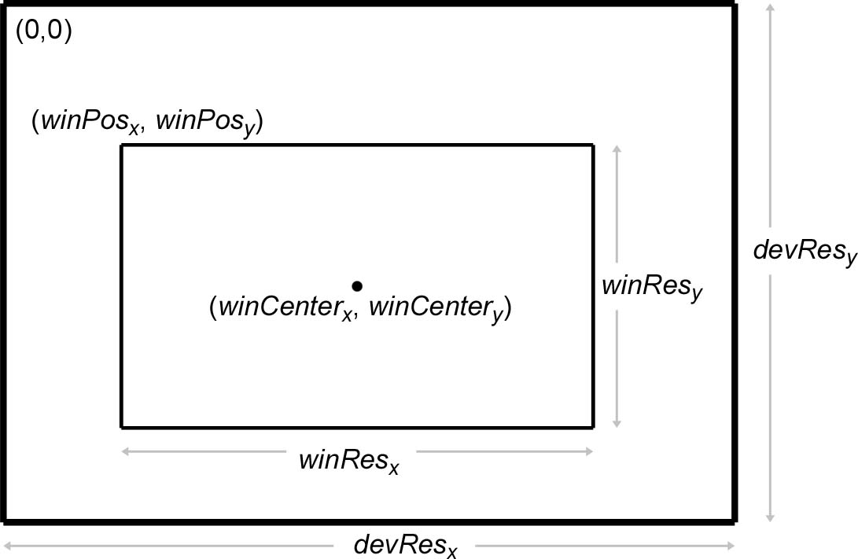

Slide 28
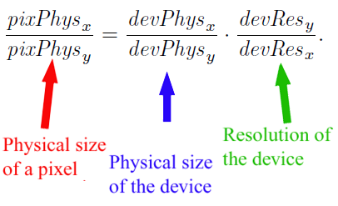
Pixel Aspect Ratio
The ratio of a pixel’s height to its width.
Function of the device physical size & resolution.
Size doesn’t matter – it’s the ratio that matters.

Slide 29
Physical Size of the Device
The viewable area on most monitors has a ratio of 4:3.
Another common ratio is 16:9 on high-definition televisions and DVDs.
For example, on a standard 4:3 monitor, many common resolutions have square pixel ratios; 320 x 240, 640 x 480, 800 x 600, 1024 x 768, and 1600 x 1200.

Slide 30
The Frustum
The view frustum is the volume of space that is visible to the camera.
Shaped like pyramid with tip snipped off.
The view frustum is bounded by six planes, known as the clip planes.
top, left, bottom, and right planes
near clip plane: prevents objects from getting too close to the camera
far clip plane: far objects eventually get too small to render effectively and can be clipped entirely.
Notes:
That’s “frustum”, not “frustrum”. Make sure you get it right!

Slide 32
Camera Properties
Position
Orientation
Field of view
Zoom
Actually, the last two are interrelated.

Slide 33
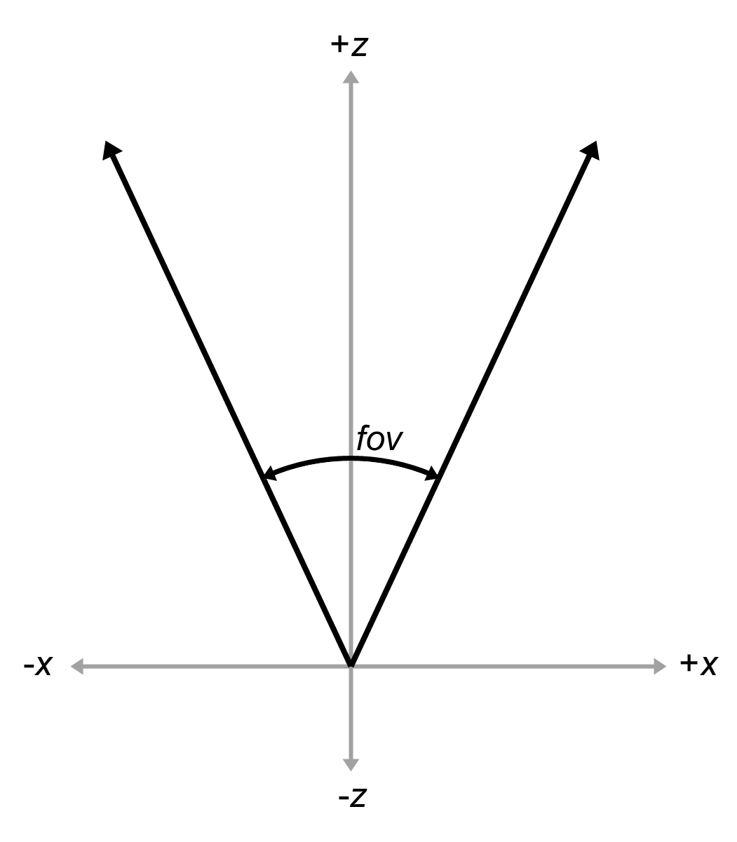
Field of View
The field of view is the angle intercepted by the view frustum.
Abbreviation: fov.
Actually, we need both a horizontal and a vertical fov angle.
Eg. Horizontal fov is shown here.

Slide 34
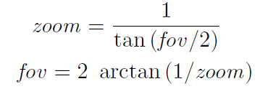
Zoom
Zoom measures the ratio of the apparent size of the object relative to a 90° fov.
Larger numbers zoom in. Smaller numbers zoom out.
For example, a zoom of 2.0 means that the object will appear twice as big on screen as with a 90° fov.
A zoom of 1.0 means a fov of 90°.
Fov-zoom equation:

Slide 35
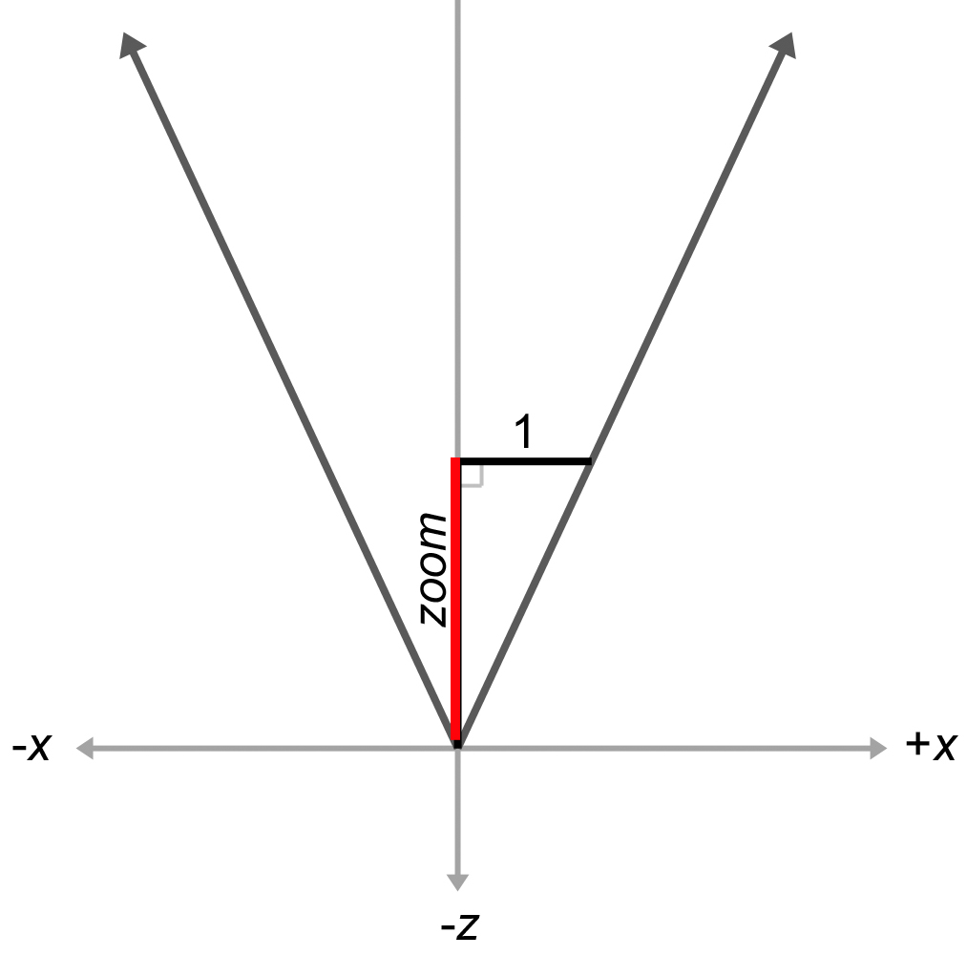

Slide 36
3D Zooms
In 3D, we need two different zoom values, one for the horizontal and one for the vertical.
We can choose any two arbitrary values, but if we do not maintain a proper relationship between the horizontal and vertical zoom, then the rendered image will appear stretched.

Slide 37
Zoom Ratio
In the formula on the next slide:
zoom refers to the camera's zoom values.
winPhys refers to the physical window size.
winRes refers to the resolution of the window, in pixels.
pixPhys refers to the physical dimensions of a pixel.
devPhys refers to the physical dimensions of the output device. Remember that we usually don't know the individual sizes, but we do know the ratio.
devRes refers to the resolution of the output device.

Slide 38
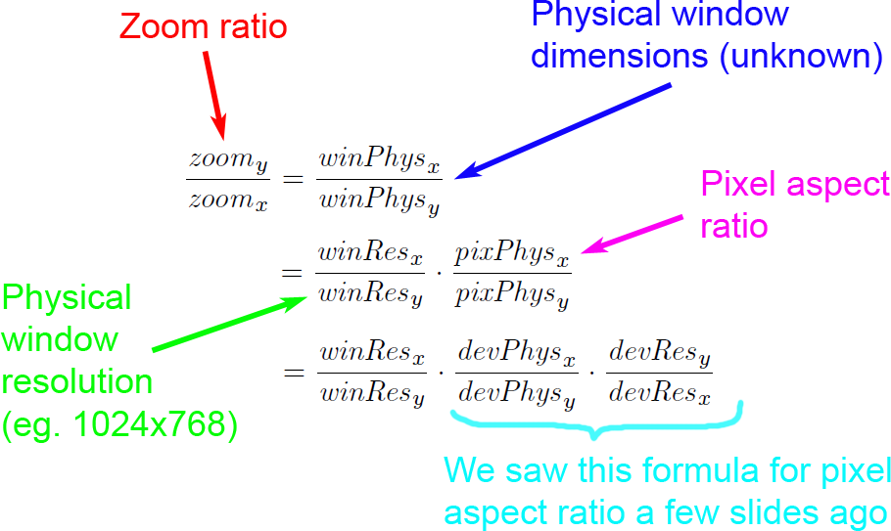

Slide 39
Specifying FOV or Zooms
Many rendering packages allow you to specify the camera using only one field of view angle (or zoom value).
When you do this, they automatically compute the other value for you, assuming you want uniform display proportions.
For example, you may specify the horizontal field of view, and they compute the vertical field of view for you. Or vice-versa.

Slide 40
Orthographic Projection
We introduced orthographic projection in Chapter 5, but to briefly review, in orthographic projection, the lines of projection are parallel, rather than intersecting at a single point.
There is no perspective foreshortening in orthographic projection; an object will appear the same size on the screen no matter how far away it is, and moving the camera forward or backwards along the viewing direction has no apparent effect so long as the objects remain in front of the near clip plane.

Slide 41
Perspective Projection
Notice that with perspective projection, parallel lines do not remain parallel, and the closer grid squares are larger than the ones in the distance.

Slide 42
Orthographic Projection
With orthographic projection, the grid
lines remain parallel and the grid squares are all the same size .

Slide 43
Orthographic Fov
For an orthographic projection, it makes no sense to speak of the field of view as an angle, since the view frustum is shaped like a box, not a pyramid.
Rather than defining the x and y dimensions of the view frustum using two angles, we instead give two sizes: the physical width and height of the box.
The zoom value has a different meaning in orthographic projection compared to perspective.
It is related to the physical size of the frustum box:
zoom = 2/size
size = 2/zoom

Slide 44
Orthographic Zoom Ratio
As with perspective projections, there are two different zoom values, one for x and one for y, and their ratio must be coordinated with the aspect ratio of the rendering window.
We developed the zoom equation about 5 slides ago with perspective projection in mind, but it works for orthographic projection too. Here it is again:

Slide 45
Section 10.3: Coordinate Spaces

Slide 46
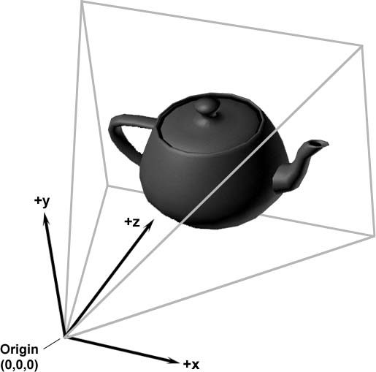
Coordinate Spaces
Object vertices specified in object space.
First transform these into world space.
Keep track of the object’s orientation and position in world space
Called the model transform or object transform.
Then transform into camera space
Use inverse of the camera’s object transform

Slide 47
A New Coordinate Space
Clip space.
AKA canonical view volume space.
The matrix that transforms vertices from camera space into clip space is known as the clip matrix.
The clip matrix serves two primary functions:
Copy z into w so that the homogenous division by w performs a perspective projection..
Scale x, y, and z so that they can be compared against w for clipping.

Slide 48
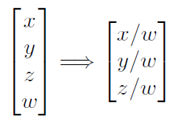
Homogenous Vectors Again
Recall that a 4D homogenous vector is mapped to the corresponding physical 3D vector by dividing by w:

Slide 49
Projection Revisited
One goal of the clip matrix is to get the right value into w so that the proper projection occurs.
We know how to project onto a plane perpendicular to the z-axis and d units away from the origin (the plane z = d.)
The rectangular portion of the projection plane inside the view frustum gets mapped onto the screen.

Slide 50
Varying Focal Distance
If we vary the focal distance d, we move the projection plane forward or backward.
In a real camera, varying the focal distance causes the camera to zoom in or out.
However, this does not occur with the projection plane in a computer.

Slide 51
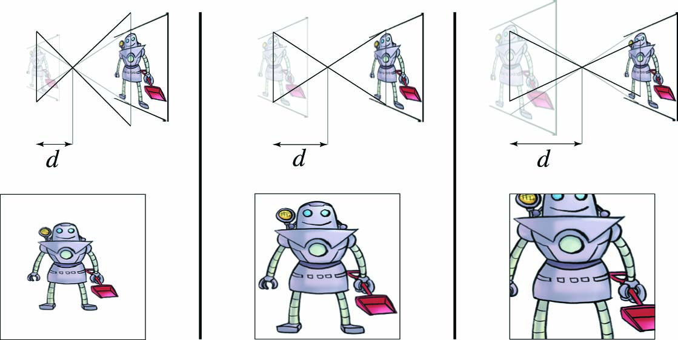
Why Not?
In a real camera, the image projection gets bigger as we increase the focal distance, and the film stays the same size.

Slide 52
Why Not? (Continued)
Inside a computer, as we increase the focal distance d:
the image projection gets bigger
the “film” (that is, the rectangular portion of the projection plane that is inside the view frustum) will also get bigger
But…

Slide 53
Why Not? (Continued)
The film has to be scaled to the screen.
Because the film and projection increase by the same proportion, there is no change in the rendered image on the screen.
The zoom is controlled completely by the shape of the view frustum, and the value of d is not really significant.
So we can pick any value for d.
The most convenient value is d = 1.

Slide 54
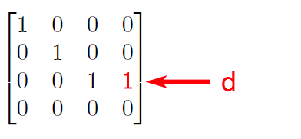
Clip Matrix: First Cut
If this was the only purpose of the clip matrix, it would simply be:

Slide 55
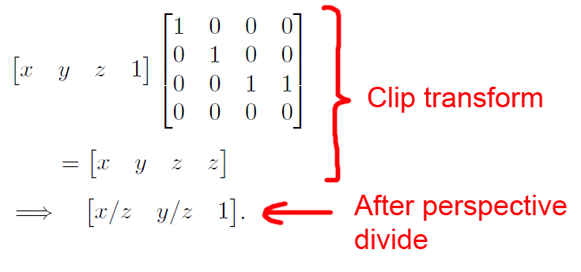
Perspective Clip Matrix
Multiplying vector [x, y, z, 1] by this matrix, then performing the perspective divide gives:

Slide 56
Orthographic Clip Matrix
For orthographic projection we don’t want the perspective divide.
Take d = 0, so the clip matrix is the identity matrix.
Set w = 1.

Slide 57
Clip Planes
The second goal of the clip matrix is to scale the x, y, and z components such that the six clip planes have a trivial form.
Points are outside the view frustum planes according to the inequalities below left.
Points inside the view frustum satisfy the inequalities below right.
Bottom | y < –w
Top | y > w
Left | x < –w
Right | x > w
Near | z < –w
Far | z > w
–w ≤ x ≤ w
–w ≤ y ≤ w
–w ≤ z ≤ w

Slide 58
Zoom in the Clip Matrix
To stretch things to put the top, left, right, and bottom clip planes in place, we scale the x and y values by the zoom values of the camera.
We discussed how to compute these values in earlier.
For the near and far clip planes, the z coordinate is biased and scaled such that at the near clip plane, z/w = –1, and at the far clip plane, z/w = 1.
Let zoom_{x} and zoom_{y} be the horizontal and vertical zoom values, and let n and f be the distances to the near and far clipping planes.

Slide 59
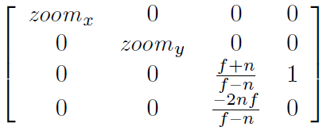
Zooming Clip Matrix
Then the following matrix scales x, y, and z appropriately, while simultaneously outputting the z coordinate into w.
This clip matrix assumes a left-handed coordinate system, row vectors on the left, and z values ranging from –w to w from the near to far clip plane.

Slide 60
DirectX
DirectX wants the projection matrix such that z ranges from 0 to w. In other words, the clip space inequalities become:
Outside:
Bottom | y < –w
Top | y > w
Left | x < –w
Right | x > w
Near | z < 0
Far | z > w
Inside:
–w ≤ x ≤ w
–w ≤ y ≤ w
0 ≤ z ≤ w

Slide 61
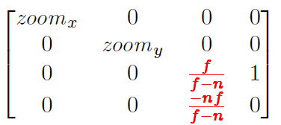
DirectX Clip Matrix
The clip matrix for DirectX becomes:

Slide 62
Orthographic Version
We can easily tell that the two matrices just given are perspective projection matrices because the right-hand column is [0, 0, 1, 0]^{T}.
What about orthographic projection? The first and second columns don't change, and we know the fourth column will become [0, 0, 0, 1]^{T}.
The third column, which controls the output z value, need to change.
Start by assuming the first set of conventions, that is we wish the output z value to be scaled such that z/w takes on the values –1 and +1 at the near and far clip planes, respectively.

Slide 63
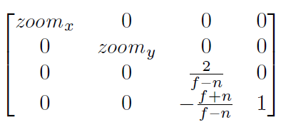
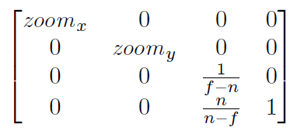
Orthographic Clip Matrices
The clip matrix is as follows, with the DirectX version on the right:

Slide 64
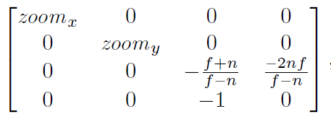
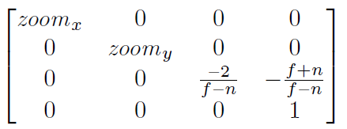
OpenGL Versions
OpenGL has a left-handed coordinate system and column vectors. Hence the clip matrices are a follows, perspective on the left and orthographic on the right.

Slide 65
The Near Clip Plane
Now that we know a bit about clip space, we can understand the need for the near clip plane.
There is a singularity precisely at the origin, where a perspective projection is not defined, corresponding to a division by zero in the perspective divide.
In practice, this singularity would be extremely rare and we can kluge it by arbitrarily projecting the point to the center of the screen, since putting the camera directly in a polygon isn't often needed in practice.

Slide 66
Overflow Risk with w
But just projecting polygons onto pixels isn't the only issue. Allowing for arbitrarily small (but positive) values of z will result in arbitrarily large values for w.
Depending on the hardware, this can cause problems with perspective correct rasterization.
Another potential problem area is depth buffering.
For practical reasons it is necessary to restrict the range of the z values so that there is a known minimum value, and we must accept the rather unpleasant necessity of a near clip plane.

Slide 67
Screen Space
Once we have clipped the geometry to the view frustum, it is projected into screen space, which corresponds to actual pixels in the frame buffer.
Remember that we are rendering into an output window that does not necessarily occupy the entire display device.
However, we usually want our screen space coordinates to be specified using coordinates that are absolute to the rendering device.

Slide 68
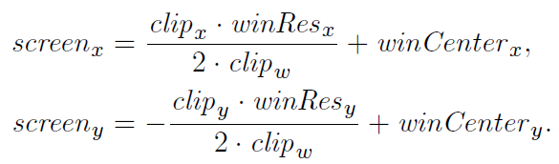
Projecting to Screen Space
We must project the points from clip space to screen space to generate the correct 2D coordinates.
The first thing that happens is the homogenous division by w. (OpenGL calls the result of this division the normalized device coordinates.)
Then, the x and y coordinates must be scaled to map into the output window as follows (see next slide for definitions.

Slide 70
But screen_{y} has a Minus Sign
A quick word about the negation of the y component in the math 2 slides ago. This reflects a DirectX-style coordinate convention where (0,0) is in the upper left corner.
Under these conventions, +y points up in clip space, but down in screen space. In fact, if we continue to think about +z pointing into the screen, then screen space actually becomes a right-handed coordinate space, even though it's left-handed everywhere else in DirectX.
In OpenGL, the origin is in the lower left corner, and the negation of the y coordinate does not occur.
As was already discussed, in OpenGL, they choose a different place to introduce confusion, by flipping the z-axis between eye space where –z points into the screen, to clip space where +z points into the screen.

Slide 71
w-buffering
Speaking of z, what happens to clip_{z}? The precise details can vary, but in general it's used in some way for depth buffering.
A traditional method is to take the normalized depth value clip_{z}/clip_{w} and store this value in the depth buffer.
An alternative strategy, known as w-buffering is to use clip_{w} as the depth value. In most situations clip_{w} is simply a scaled version of the camera-space z value, and thus by using clip_{w} in the depth buffer, each value has a linear relationship to the viewing depth of the corresponding pixel.
This method can be attractive if the depth buffer is fixed-point with limited precision, because it spreads out the available precision more evenly.

Slide 72
w-buffering
The traditional method of storing clip_{z}/clip_{w} in the depth buffer results in greatly increased precision up close, at the expense of (sometimes drastically) reduced precision near the far clip plane.
The precise details will depend on exactly what sort of clip values are used for clipping, and what sort of depth values go into the depth buffer. For example, in OpenGL, the conceptual convention is for the view frustum to contain –1 ≤ clip_{z}/clip_{w} ≤ 1, but this might not be optimal for depth buffering. Driver vendors must convert from the API's conceptual conventions to whatever is optimal for the hardware.
If the depth buffer values are stored in floating point, this issue is much less important.
Also note that this doesn't work for orthographic projection, since an orthographic projection matrix always outputs w = 1.

Slide 73
Other Uses for clip_{w}
The clip_{w} value is usually not discarded.
It serves the important purpose as the denominator in the homogenous division to normalized device coordinates.
It is also needed for proper perspective-correct interpolation of texture coordinates, colors, and other vertex-level values during rasterization.
On modern graphics APIs at the time of this writing, the conversion of vertex coordinates from clip space to screen space is done for you. Your vertex shader will output coordinates in clip space. The API will clip the triangles to the view frustum, and then project the coordinates to screen space.
But that doesn't mean that you will never use the equations in your code. Quite often we need to perform these calculations in software for visibility testing, level-of-detail selection, etc.

Slide 74
More Coordinate Spaces
There are more spaces that are used in computer graphics.
For example, a projected light might have its own space, which is essentially the same as camera space, only it is from the perspective that the light looks onto the scene.
This space is important when the light projects an image (sometimes called a gobo, we’ll return to this later), and also for shadow mapping, to determine if a light can see a given point.

Slide 75
Tangent Space
Tangent space is a local space on the surface of an object, with one basis vector the surface normal, and the other two basis vectors locally tangent to the surface.
This establishes a 2D coordinate space that is flat on the surface at a given spot.
By far the most common reason to establish such a coordinate space is for bump mapping and related techniques.
More on this when we cover texture mapping later.
Tangent space is sometimes called surface-local space.

Slide 76
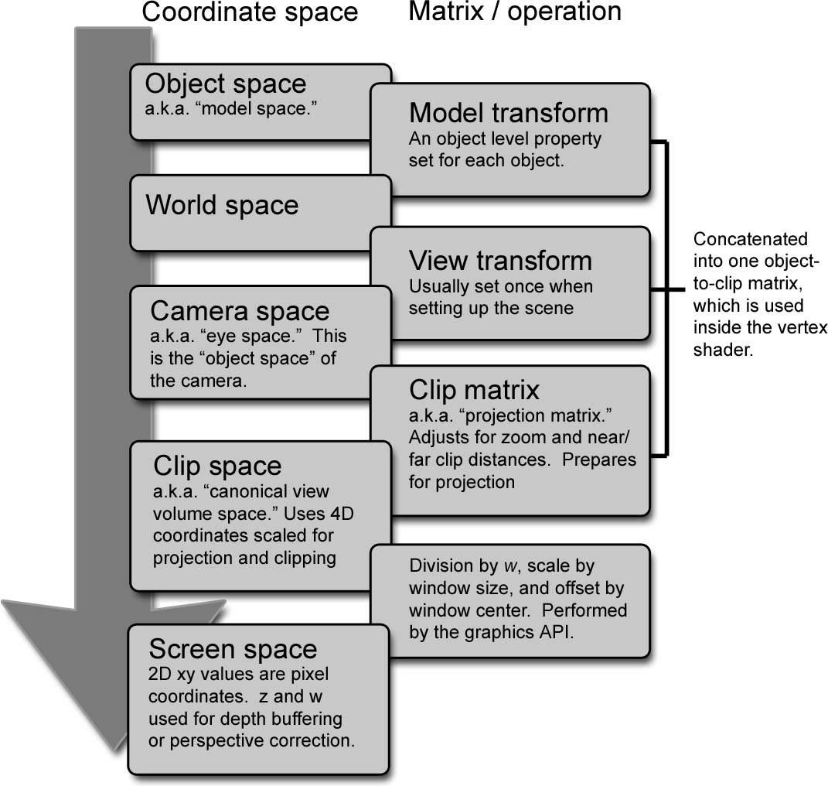

Slide 77
Section 10.4: Triangle Meshes

Slide 78
CSG
Constructive solid geometry (CSG) is a system for describing an objects shape using Boolean operators (union, intersection, subtraction) on primitives.
Within video games, CSG can be especially useful for rapid prototyping tools, with the Unreal engine being a notable example.

Slide 79
Metaballs
Metaballs are used to model organic shapes and fluids.
A three dimensional scalar density function is defined surrounding each ball based on the distance to the center.
By summing the density over all the balls, we can define an aggregate density function for any arbitrary point in space.
The trick to metaballs is that the volume of the object is defined to be the region where the density exceeds some nonzero threshold.
Thus balls have a fuzzy region around them that extends outside of the volume when the ball is in isolation.
When two or more balls come together, the fuzzy regions interfere constructively, causing a graceful bond of solid volume to materialize in the region in between the balls, where no such solid would exist if either ball were there alone.

Slide 80
Triangle Meshes
CSG, metaballs, and other volumetric descriptions are very useful in particular realms, but for rendering (especially real-time rendering) we are interested in a description of the surface of the object, and seldom need to determine whether a given point is inside or outside this surface. Indeed, the surface need not be closed or even define a coherent volume.
The most common surface description is the polygon mesh.
In certain circumstances it's useful to allow the polygons that form the surface of the object to have an arbitrary number of vertices; this is often the case in importing and editing tools.
For real-time rendering, however, modern hardware is optimized for triangle meshes, which are polygon meshes where every polygon is a triangle.

Slide 81
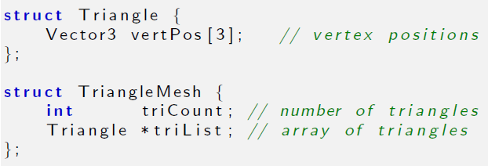
Trivial Mesh Representation
One very straightforward way to store a triangle mesh would be to use an array of triangles.

Slide 82
Triangle Mesh Information
For some applications this trivial representation might be adequate.
However, the term mesh implies connectivity between adjacent triangles, and this connectivity is not expressed in our trivial representation.
There are three basic types of information in a triangle mesh:
Vertices
Edges
Faces

Slide 83
Triangle Mesh Information
Vertices. Each triangle has exactly three vertices. Each vertex may be shared by multiple triangles. The valence of a vertex refers to how many faces are connected to the vertex.
Edges. An edge connects two vertices. Each triangle has three edges. In many cases, each edge is shared by exactly two faces, but there are certainly exceptions. If the object is not closed, an open edge with only one neighboring face can exist.
Faces. These are the surfaces of the triangles. We can store a face as either a list of three vertices, or a list of three edges.

Slide 84
Triangle Mesh
An indexed triangle mesh consists of two lists: a list of vertices, and a list of triangles.
Each vertex contains a position in 3D.
We may also store other information at the vertex level, such texture mapping coordinates, surface normals, or lighting values.
A triangle is represented using three indices into the vertex list. Usually the order that these vertices are listed is significant, since we may consider faces to have a front and a back sides.
We will adopt the convention that the vertices are listed in clockwise order when viewed from the front side.
Other information may also be stored at the triangle level, such as a precomputed normal of the plane containing the triangle, surface properties (such as a texture map), etc.

Slide 85
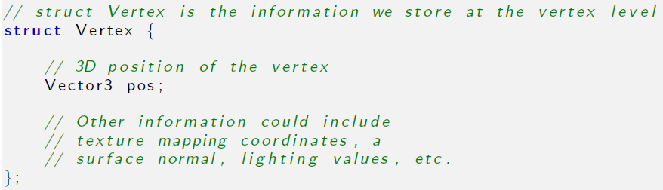
Vertex Structure

Slide 86
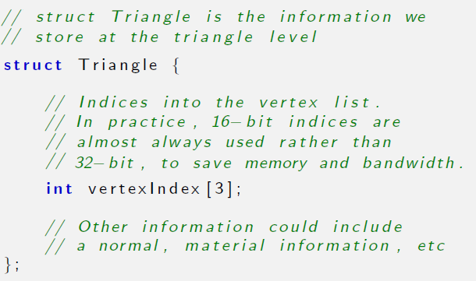
Triangle Structure

Slide 87
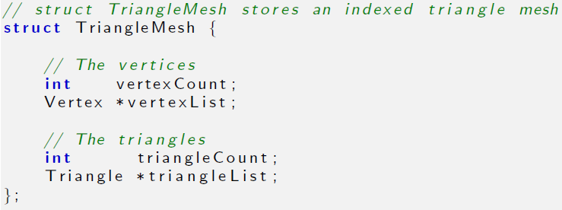
Triangle Mesh Structure

Slide 88
Example
Here is how a cube and a pyramid might be represented as a polygon mesh or a triangle mesh. Note that in either case, it is a single mesh with 13 vertices. The lighter, thicker wires show the outlines of polygons, and the green wires show one way to add additional edges to triangulate the polygon mesh.

Slide 89
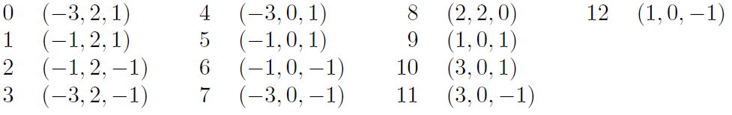
Example: Vertex Coordinates
Assuming the origin is on the ground directly in between the two objects, these might be the vertex coordinates.

Slide 90
Example Mesh Table
The table on the next slide shows the vertex indices that would form faces of this mesh, either as a polygon mesh, or as a triangle mesh.
Note that the order of the vertices is significant.
While the vertices must be listed in clockwise order around a face, it doesn't matter which one is considered first vertex; they can be cycled without changing the logical structure of the mesh.
For example, the quad forming the cube top could equivalently been given as:
{1, 2, 3, 0}, {2, 3, 0, 1}, or {3, 0, 1, 2}.

Slide 91
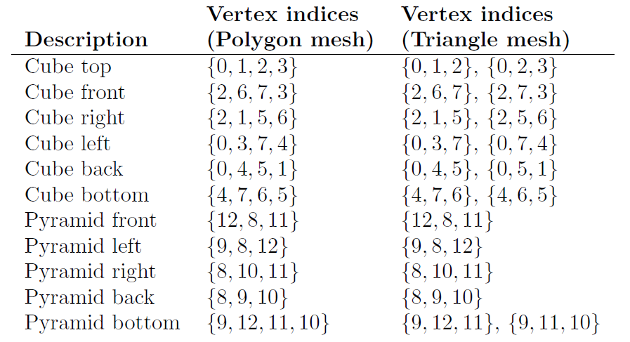

Slide 92
Implementation Notes
Additional data is almost always stored per vertex, such as texture coordinates, surface normals, basis vectors, colors, skinning data, etc.
Additional data can also be stored at the triangle level, such as an index that tells which material to use for that face, or the plane equation for the face. This is highly useful for editing purposes or in other tools that perform mesh manipulations.
For real-time rendering, however, we seldom store additional data at the triangle level. In fact, its very common to not have a struct Triangle at all, and simply represent the entire list of triangles as an array like unsigned short [], where the length of the array is the number of triangles times three.
Triangles with identical properties are grouped into batches so that an entire batch can be fed to the GPU in this optimal format.
We recommend that you don’t try to use the same mesh class for both rendering and editing. The requirements are very different, and a bulkier data structure with more flexibility is best for use in tools etc.

Slide 93
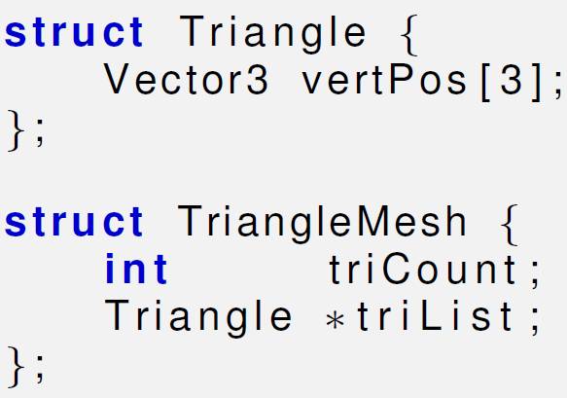
Implementation Notes
Note that in an indexed triangle mesh, the edges are not stored explicitly, but rather the adjacency information contained in an indexed triangle list is stored implicitly: to locate shared edges between triangles, we must search the triangle list.
Our original trivial “array of triangles” format did not have any logical connectivity information.
However, what’s surprising is that the “extra” connectivity information contained in the indexed representation actually results in a reduction of memory usage in most cases, compared to the flat method.
The reason for this is that the information stored at the vertex level, which is duplicated in the trivial flat format, is relatively large compared to a single integer index. (At the minimum, we most store a 3D vector position.)
In meshes that arise in practice, a typical vertex has 3–6 neighbors, which means that the flat format duplicates quite a lot of data.

Slide 94
Implementation Notes
The simple indexed triangle mesh scheme is appropriate for many simple applications, including the very important one of rendering.
However, some operations on triangle meshes require a more advanced data structure in order to be implemented more efficiently.
The basic problem is that the adjacency between triangles is not expressed explicitly and must be extracted by searching the triangle list.
Other representation techniques make this information available in constant time.
One idea is to maintain an edge list explicitly.
Each edge is defined by listing the two vertices on the ends.
We also maintain a list of triangles that share the edge.
Then the triangles can be viewed as a list of three edges rather than a list of three vertices, so that they are stored as three indices into the edge list rather than the vertex list.
An extension of this idea is known as the winged edge model, which also stores, for each vertex, a reference to one edge that uses the vertex. The edges and triangles may be traversed intelligently to quickly locate all edges and triangles that use the vertex.

Slide 95
Surface and Vertex Normals
A surface normal is a unit vector that is perpendicular to a surface.
We might be interested in the normal of a given face, in which case the surface we are interested in is the plane that contains the face.
The surface normals for polygons can be computed easily using cross product of two sides. Care must be taken to get the direction right.
Vertex-level normals are a bit trickier.
First, it should be noted that strictly speaking there is not a true surface normal at a vertex (or an edge for that matter) since these locations mark discontinuities in the surface of the polygon mesh.
Rather, for rendering purposes we typically interpret a polygon mesh as an approximation to some smooth surface.

Slide 96
Normals and Lighting
The primary purpose of vertex normals is for lighting.
Practically every lighting model takes a surface normal at the spot being lit as an input.
Indeed, the surface normal is part of the rendering equation itself (in the Lambert term) and so it is always a factor, even if the BRDF does not depend explicitly on it.
We only store normals at the vertices, but yet we need to compute lighting values over the entire surface.

Slide 97
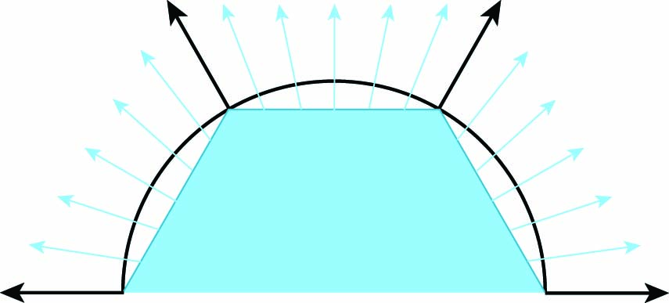
What to Do?
If hardware resources permit, then we can approximate the normal of the continuous surface corresponding to any point on a given face by interpolating vertex normals and renormalizing the result.
This is illustrated below: a cross section of a cylinder (black circle) is being approximated by a hexagonal prism (blue).
Black normals at the vertices are the true surface normals, while the interior normals are being approximated through interpolation.
The actual normals used would be the result of stretching these to unit length.

Slide 98
Gouraud and Phong Shading
Once we have a normal at a given point, we can perform the full lighting equation per pixel.
This is known as per-pixel shading, or Phong shading.
An alternate strategy to per-pixel shading, known as Gouraud shading, is to only perform lighting calculations at the vertex level, and then interpolate the results themselves, rather than the normal, across the face.
This requires less computation, and is still done on some systems such as the Nintendo Wii.

Slide 99
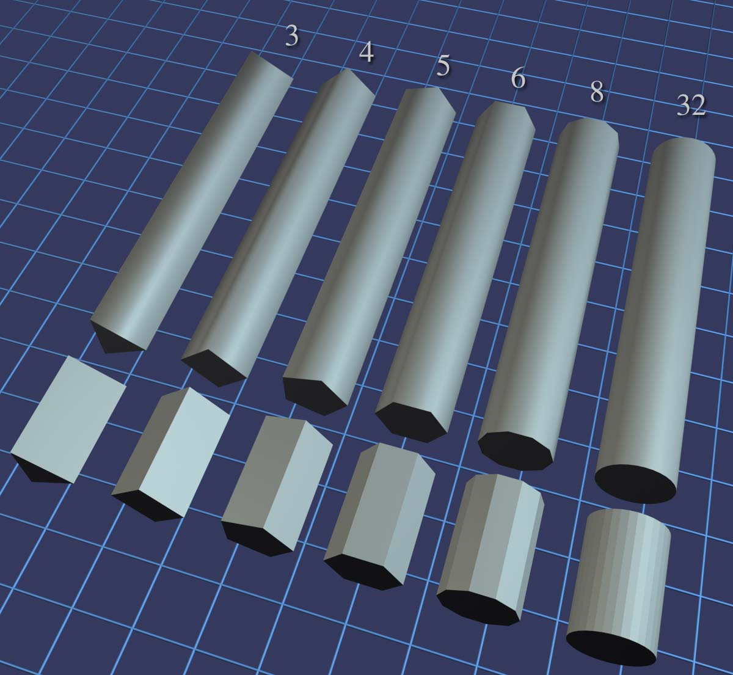
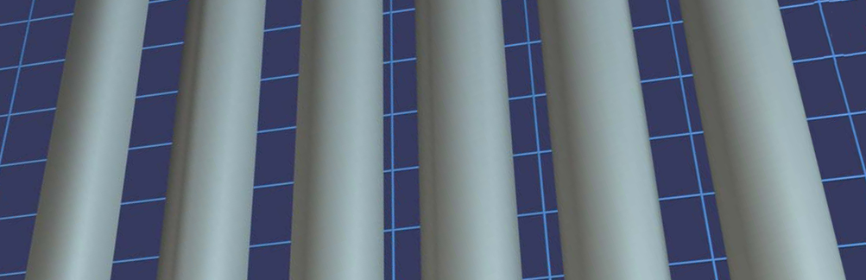
Phong Shading
Here is per-pixel lighting of cylinders with different numbers of sides.
Although the illusion breaks down on the ends of the cylinder, this method of approximating a smooth surface can make even a very low-resolution mesh look smooth.
Cover up the ends of the cylinder, and even the 5-sided cylinder is remarkably convincing.

Slide 100
Back to Vertex Normals
If the mesh is generated procedurally, for example from a parametric curved surface, then the vertex normals can be supplied.
Or you may simply be handed the vertex normals from the modeling package as part of the mesh.
However, sometimes the surface normals are not provided, and we must approximate them by interpreting the only information available to us: the vertex positions and the triangles.
One trick that works is to average the normals of the adjacent triangles, and then re-normalize the result, as follows..

Slide 101
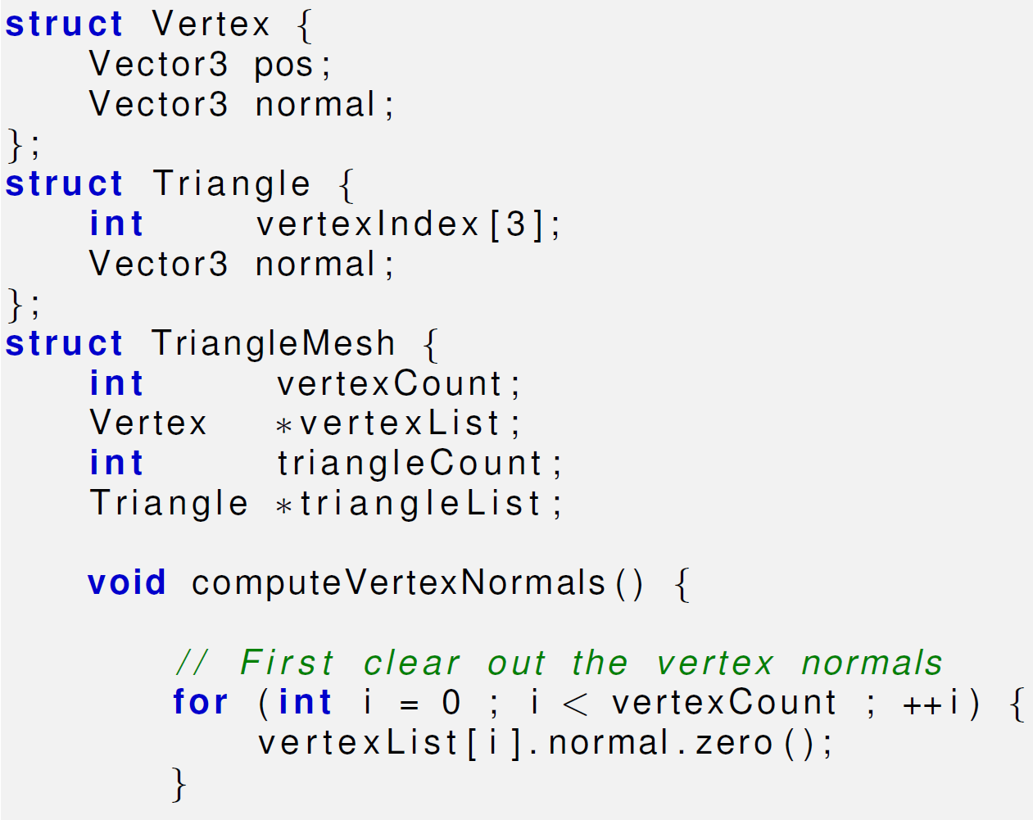

Slide 102
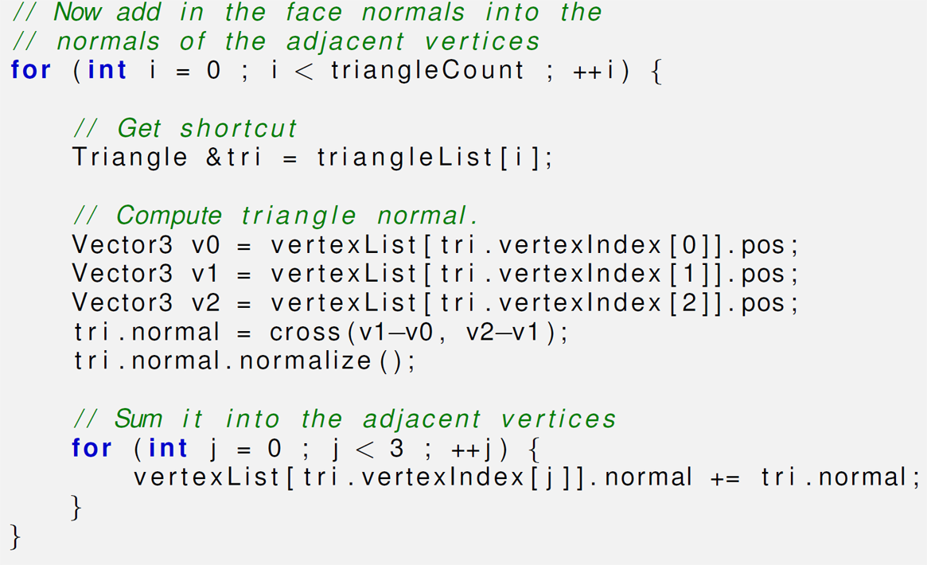

Slide 103
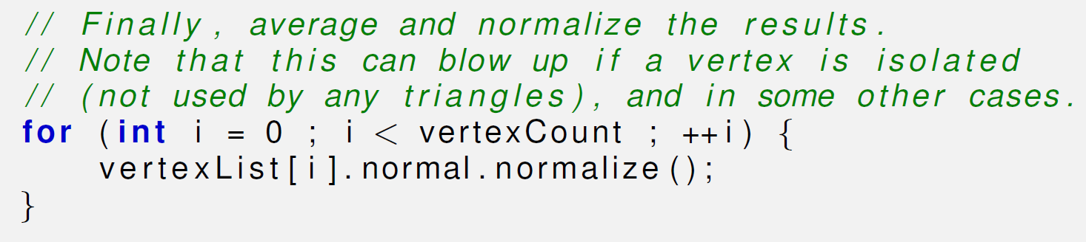

Slide 104
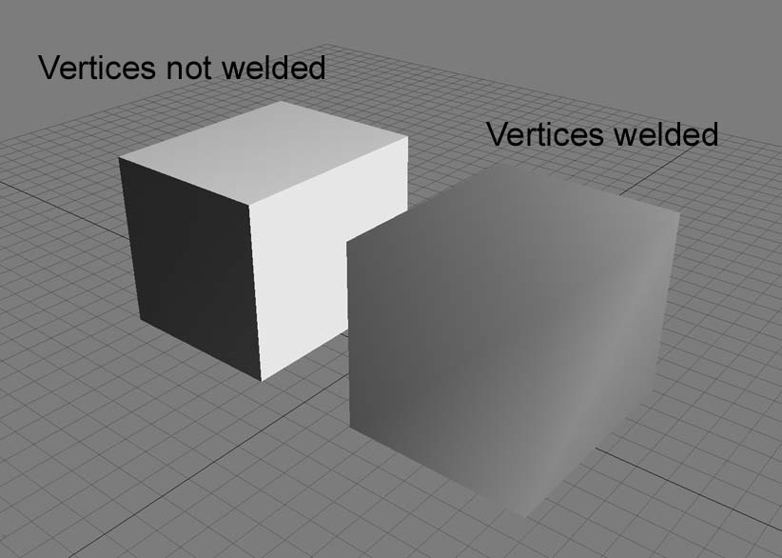
A Gotcha
Averaging face normals to compute vertex normals is a tried-and-true technique that works well in most cases.
However, there are a few things to watch out for, as this picture shows.
Sometimes the mesh is supposed to have a discontinuity, and if we’re not careful, this discontinuity could get smoothed out.
Take the very simple example of a box. There should be a sharp lighting discontinuity at its edges.
However, if we use vertex normals computed from the average of the surface normals, then there is no lighting discontinuity.

Slide 105
Detaching Faces
The basic problem is that the surface discontinuity at the box edges cannot be properly represented because there is only one normal stored per vertex.
The solution to this problem is to detach the faces; in other words, duplicate the vertices along the edge where there is a true geometric discontinuity.
In doing so, we create a discontinuity to prevent the vertex normals from being averaged. At this point, the faces are no longer logically connected, but this seam in the topology of the mesh doesn’t cause a problem for many important tasks such as rendering and ray tracing.
Next, cubes with welded vs. detached faces…

Slide 106
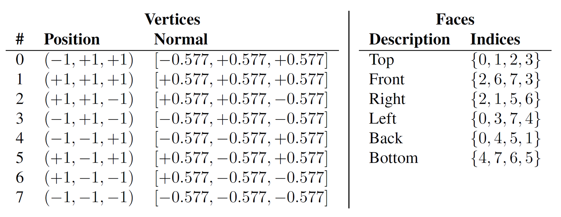
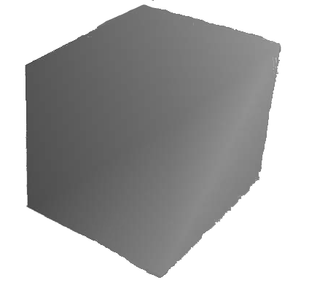
Cube with Welded Faces

Slide 107
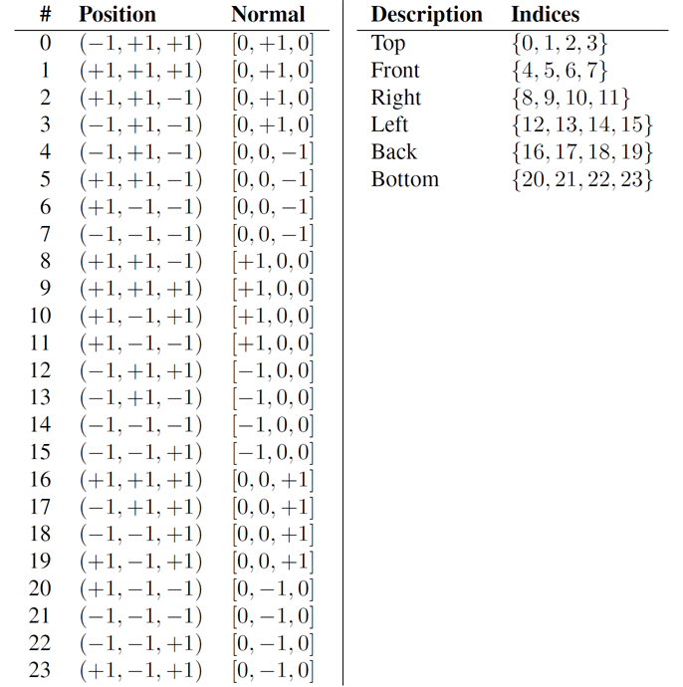

Cube with Detached Faces

Slide 108
Billboards
An extreme version of this situation occurs when two faces are placed back-to-back, which is called a billboard.
Such infinitely thin double-sided geometry can arise with foliage and cloth.
In this case, since the normals are exactly opposite, averaging them produces the zero vector, which cannot be normalized.
The simplest solution is to detach the faces so that the vertex normals will not average together.
Or if the front and back sides are mirror images, the two single-sided polygons can be replaced by one double-sided one.
This requires special treatment during rendering to disable backface culling (more later) and dealing with the normal intelligently in the lighting equation.

Slide 109




When Unweighted Averaging is Wrong
A more subtle problem is that unweighted averaging is biased towards large numbers of triangles with the same normal.
For example, consider vertex at index 1 in the leftmost picture.
This vertex is adjacent to two triangles on the top of the cube (second picture, red and yellow triangles), but only one triangle on the right side (third picture, green triangle ) and one triangle on the back side (rightmost picture, pink triangle).
The vertex normal computed by averaging the triangle normals is biased because the top face normal effectively gets twice as many votes as the side face normals.

Slide 110


Edge Turning
But this topology is the result of an arbitrary decision as to where to draw the edges to triangulate the faces of the cube.
For example, if we were to triangulate the top face by drawing an edge between vertices 0 and 2 (this is known as turning the edge, see pictures at right), all of the normals on the top face would change.
Techniques exist to deal with this problem, such as weighing the contribution from each adjacent face based on the interior angle adjacent to the vertex. But it’s often ignored in practice.
Most of the really terrible examples are contrived ones like this, where the faces should be detached, anyway.
Furthermore, the normals are an approximation to begin with, and having a slightly perturbed normal is often difficult to tell visually.

Slide 111
Covariant and Contravariant Vectors
Surface normals cannot be transformed using the same matrix that is used to transform positions.
This is an entirely separate issue from the fact that normals should not be translated like positions.
The reason for this is that normals are covariant vectors.
Vectors such as position and velocity are said to be contravariant: If we scale the coordinate space used to describe the vector, the coordinates will respond in the opposite direction.
If we use a coordinate space with a larger scale (for example, using meters instead of feet) the coordinates of a contravariant vector respond to the contrary by becoming smaller.
Notice that this is all about scale; translation and rotation are not part of the discussion.
Normals and other types of gradients, known as dual vectors, do not behave like this.

Slide 112
Example of Contravariance
Imagine we stretch a 2D object such as a circle horizontally.
Notice that the normals begin to turn to point more vertically—the horizontal coordinates of the normals are decreasing in absolute value, as the horizontal coordinates of the positions are increasing.
A stretching of the object (object getting bigger while coordinates space stays the same) has the same effect as scaling down the coordinate space while holding the object at the same size.
The coordinates of the normal change in the same direction as the scale of the coordinate space, which is why they are called covariant vectors.

Slide 113
Transforming Surface Normals
To properly transform surface normals we must use the inverse transpose of the matrix used to transform positions; that is, the result of transposing and inverting the matrix.
This is sometimes denoted M^{–T} , since it doesn’t matter if we transpose first, or invert first, that is, (M^{–1})^{T}= (M^{T}) ^{–1}
If the transform matrix doesn’t contain any scale (or skew), then the matrix must be orthonormal, and thus the inverse transpose is simply the same as the original matrix, and we can safely transform normals using it.
If the matrix contains uniform scale, then we can still ignore this, but we must re-normalize the normals after transforming them.
If the matrix contains non-uniform scale (or skew), then to properly transform the normals we must use the re-normalized inverse transpose transform matrix.

Slide 114
Section 10.5: Texture Mapping

Slide 115
Texture Mapping
A texture map is a bitmap image that is pasted onto the surface of an object.
A texel is a single pixel in a texture map.
Planar mapping projects the texture orthographically onto the mesh. Spherical, cylindrical, and cubic mapping are various methods of wrapping the texture around the object.
The key point is that, at each point on the surface of the mesh, we can obtain texture mapping coordinates, which define the 2D location in the texture map that corresponds to this 3D location.
Traditionally, these coordinates are assigned the variables (u, v), where u is the horizontal coordinate and v is the vertical coordinate, thus texture mapping coordinates are often called UV coordinates or simply UV’s.

Slide 116

UV Coordinates
Although bitmaps come in different sizes, UV coordinates are normalized such that the mapping space ranges from 0 to 1 over the entire width (u) or height (v) of the image, rather than depending on the image dimensions.
The origin of this space is either in the upper-left-hand corner of the image (DirectX), or in the lower left corner (OpenGL).
We’ll use DirectX conventions.

Slide 117

Example

Slide 118


Repeating and Clamping
UV coordinates outside of the range 0 to 1 are allowed.
Such coordinates are interpreted in a variety of ways. The most common addressing modes are repeat (also known as tile or wrap) and clamp.
When repeating is used, the integer portion is discarded and only the fractional portion is used, causing the texture to repeat, as shown in the top image.
Under clamping, when a coordinate outside the range 0 to 1 is used to access a bitmap, it is clamped in range. This has the effect of streaking the edge pixels of the bitmap outwards, as depicted in the bottom image.

Slide 119
More on Texture Mapping
There are other options supported on some hardware, such as mirror, which is similar to repeat except that every other tile is mirrored. This can be useful because it guarantees that no seam will exist between adjacent tiles.
On most hardware, the addressing mode can be set for the u- and v-axes independently.
It’s important to understand that these rules are applied at the last moment, when the coordinates are used to index into the texture.
The coordinates at the vertex are not limited or processed in any way; otherwise they could not be interpolated across the face properly.

Slide 120


Slide 121
Section 10.6: The Standard Lighting Model

Slide 122
The Standard Lighting Model
In the rendering equation, the BRDF describes the scattering distribution for light of a given frequency and direction of incidence.
The differences in distributions between different surfaces is precisely what causes those surfaces to look different from one another.
Most BRDF’s are expressed in a computer by some sort of formula, where certain numbers in the formula are adjusted to match the desired material properties.
The formula itself is often called a lighting model, and the particular values going into the formula come from the material assigned to the surface.
It is common for a game engine to only use a handful of lighting models, even though the materials in the scene may be quite diverse and there may be thousands of different BRDF’s.
Indeed, just a few years ago almost all real-time rendering was done with a single lighting model, and the practice is not uncommon today.

Slide 123
Legacy Feature, or Reliable Standard?
This lighting model was so ubiquitous that it was hardwired into the rendering APIs of OpenGL and DirectX.
Although these older parts of the API have effectively become legacy features, the standard model is still commonly used in the more general framework of shaders and generic constants and interpolants.
The great diversity and flexibility available is usually used to determine the best way to feed the parameters into the model (for example, by doing multiple lights at once, or doing all the lighting at the end with deferred shading), rather than using different models.
At the time of writing the most popular video game console is the Nintendo Wii, which has hardwired support for the standard model.
This is a very important lesson. Realistic graphics might be important to hardcore gamers, but for a more general audience they are not nearly as important as we once believed.

Slide 124
Basic Concepts of the Standard Lighting Model
Phong Bui-Tuong introduced the basic concepts behind the standard lighting model in 1975.
Back then the focus was on a fast way to model direct reflection. While certainly researchers understood the importance of indirect light, it was a luxury that could not yet be afforded.
Thus while the standard rendering equation is an equation for the radiance outgoing from a point in any particular direction, the only outgoing direction that mattered in those days were the directions that pointed to the eye.
Similarly, while the rendering equation considers incident light from the entire hemisphere surrounding the surface normal, if we ignore indirect light, then we need not cast about in all incident directions: We need only consider those incident directions that point towards a light source.

Slide 125
The Standard Lighting Equation
Gives the color vector for a single pixel.
It’s the sum of three components:
c_{lit} = c_{emis} + c_{spec} + c_{diff} + c_{amb}
c_{emis} is the emissive component
c_{spec} is the specular component
c_{diff} is the diffuse component
c_{amb} is the ambient component
c is short for contribution or component.
There’s not much to say about c_{emis}, it’s a fixed value.

Slide 126
Lighting and Darkening
c_{lit} is the resulting lit color value, as opposed to an unlit color value, which has full lighting intensity.
Contrary to normal use of the verb light, in computer graphics the term lighting normally refers to the process of taking a color (eg. from a texture) and darkening it.
Factors affecting lighting:
The properties of the surface of the object itself (known as material properties).
The location and orientation of the surface being lit. The orientation is usually described using a surface normal.
The properties of the various lights shining on the object.
The location of the viewer.

Slide 127
The Specular Component
The specular component is what gives surfaces a shiny appearance.
Models direct reflection of light from a light source to the eye.
The amount of specular lighting depends on
the object
the lights
the viewer
Two important variants: Phong and Blinn.

Slide 128
The Phong Lighting Model
The Phong specular component depends upon these inputs:
n, the surface normal.
v a unit vector that points toward the viewer.
l a unit vector that points toward the light source. For directional lights, l is constant.
Properties of the material and the light.

Slide 129


Slide 130
Phong Parameters
r: the reflection vector, the result of reflecting l about n.
θ: the angle between r and v.
m_{gls}: the glossiness of the material, also known as the Phong exponent.
m_{spec}: the material’s specular color.
s_{spec}: the specular color of the light source.

Slide 131


Slide 132

The Reflection Vector
r is given by 2(n·l)n–l.
Why is this? It’s easier to see with pictures.

Slide 133


Slide 134


Slide 135


Slide 136


Slide 137
Glossiness
m_{gls} controls how wide the reflection hotspot is.
A smaller value results in a larger, more gradual falloff from the hotspot, and a larger value results in a very tight hotspot with sharp falloff.
Perfectly reflective surfaces, such as glass, will have a very high value for m_{gls}—only a perfectly reflected ray of light will enter the eye.
Shiny surfaces that are not perfect reflectors, like the surface of an apple, might have lower values, resulting in a larger hotspot.

Slide 138
Shininess
While m_{gls} controls the size of the hotspot, the shininess m_{spec} controls its intensity.
m_{spec}, is usually a grayscale value that is constant for the entire material.
Highly reflective surfaces will have a higher value for m_{spec}, and more matte surfaces will have a lower value.
If desired, a gloss map may be used to control the brightness of the reflections using a bitmap, much as a texture map controls the color of an object.

Slide 139
Gobos
Furthermore, even ignoring attenuation, lights don’t have to have a constant color.
For rectangular spotlights, we might determine the color from a gobo, which is a projected bitmap image.
A colored gobo might be used for a light shining through a stained glass window, or an animated gobo could be used to fake shadows of spinning ceiling fans or trees blowing in the wind.
The term gobo originated from the world of theater, where it refers to a mask or filter placed over a spotlight used to create a colored light or special effect, and it’s the term we’ll use.
Gobos are very useful for faking special lighting situations.
If canonical lights are not directly supported, they can be implemented with an appropriately designedcircular gobo

Slide 140
Specular Light Color
s_{spec} controls the basic color and intensity of the light.
For rectangular spotlights, this value may come from a projected light map.
s_{spec} is often equal to the light’s diffuse color, s_{diff}.

Slide 141

The Phong Specular Equation
Since cos θ may be negative, we clamp c_{spec} to 0 if necessary.

Slide 142

Deconstructing the Phong Specular Equation

Slide 143


Slide 144
Optimizing Phong
If the distance to the viewer is large relative to the size of an object, then v may be computed once and then considered constant for an entire object.
The same is true for a light source and the vector l. (In fact, for directional lights, l is always constant.)
However, since n is not constant, we must still compute r, a computation which we would like to avoid if possible.

Slide 145

The Blinn Model
The Blinn model uses h, the “halfway” vector between v and l, which is computed by averaging v and l and then normalizing the result:

Slide 146

The Blinn Specularity Equation
Why are we doing this? h is slightly easier to compute than r.
If the viewer and light source are far enough away from the object to be considered a constant, then h is a constant and only needs to be computed once.

Slide 147
The Diffuse Component
Specular light accounts for light that reflects perfectly off the surface into the eye.
Diffuse light models reflections that are scattered in random directions due to the rough (“diffuse”) nature of the object’s surface.

Slide 148


Slide 149
Diffuse Lighting
Diffuse lighting does not depend on the location of the viewer because the reflections are scattered randomly.
However, the position of the light source relative to the surface is important.
If count the photons of light that hit the surface of the object and have a chance of reflecting into the eye, a surface perpendicular to the rays of light receives more rays per unit area than a surface oriented at a more glancing angle.

Slide 150


Slide 151
Diffuse Lighting Model
The diffuse component depends upon these inputs:
n, the surface normal.
l a unit vector that points toward the light source. For directional lights, l is constant.
Properties of the material and the light.

Slide 152
Diffuse Lighting Parameters
m_{diff}: the material’s diffuse color. This is the value that most people think of when they think of the color of an object (usually comes from a texture map).
s_{diff}: the diffuse color of the light source, which is often equal to the light’s specular color, s_{spec}.

Slide 153

Lambert’s Law
Diffuse lighting obeys Lambert’s law: intensity of reflected light is proportional to the cosine of the angle between the surface normal and the rays of light.
We will compute this cosine using the dot product as usual:

Slide 154
Ambient Lighting
Specular and diffuse lighting model light rays that travel directly from the light source to the surface of the object and are then reflected to the viewer.
However, in the real world, light often bounces off of multiple intermediate objects before hitting an object and reflecting to the eye.
There’s light everywhere – this is called ambient lighting.

Slide 155

Ambient Lighting Parameters
m_{amb}: the material’s ambient color. This is almost always the same as the diffuse color m_{diff} (usually defined using a texture map).
g_{amb} is the global ambient light value for the entire scene.
The ambient lighting equation is simple:

Slide 156
Light Attenuation
Light intensity falls off with distance from the light source – inversely proportional to the square of the distance.
This is called attenuation.
To save the multiplication, light attention is often approximated using linear interpolation.

Slide 157
What Gets Attenuated?
Attenuation can be applied to point lights and spotlights—directional lights are not attenuated.
An additional attenuation factor is used for spotlights. Hotspot falloff attenuates light as we move closer to the edge of the cone.
Once we have computed the intensity multiplier i, it is applied to the diffuse and specular components. Ambient light is not attenuated.

Slide 158
Falloff Distances
Linear interpolation of light attenuation uses two parameters.
d_{min} is the minimum falloff distance. At distances d ≤ d_{min}, the light has intensity 1.0
d_{max} is the maximum falloff distance. At distances d ≥ d_{max}, the light has intensity 0.0
At distances d_{min} ≤ d ≤ d_{max} the light intensity varies with 1/d.

Slide 159

The Full Lighting Equation

Slide 160

Example
The ear is lit just as bright as the nose, even though it is actually in the shadow of the head.
This is a consequence of using a local lighting model.
For shadows, a more advanced technique must be used.

Slide 161

Specular

Slide 162

Diffuse

Slide 163

Ambient

Slide 164
Ambient
Without ambient light the side of the head that is facing away from the light is completely black.
In order to light the back side of objects, you must use ambient light.
Or, you can place enough lights in your scene so that every surface is lit directly.

Slide 165
Notes
With only ambient lighting, just the silhouette is visible.
Lighting is an extremely powerful visual cue that makes the object appear 3D.
The solution to this “cartoon” effect is, again, to place a sufficient number of lights in the scene so that every surface is lit directly.

Slide 166

Multiple Lights
Sum the specular and diffuse components from each light source.

Slide 167
Shading Triangles
Phong shading: compute lighting equation for every pixel.
Gouraud shading: compute lighting equation at vertices and interpolate across triangle.
Flat shading: compute a single lighting value for the whole triangle.

Slide 168
Compare and Contrast
Phong shading looks best but is slow.
Flat shading looks worst but is fast.
Gouraud shading is a compromise. (It neither looks good nor is fast.)

Slide 169

Flat Shading

Slide 170

Gouraud Shading

Slide 171

Phong Shading

Slide 172
Problem with Gouraud Shading
The specular highlights don’t look as good.
The problem is that no value in the middle of the triangle can be larger than the largest value at a vertex.
So highlights can only occur at a vertex.
Partial work-around: use more triangles.

Slide 173
Using the Lighting Equation for Gouraud Shading
m_{diff} is not a vertex-level material property: usually defined by a texture map.
To make the standard lighting equation more suitable for use in an interpolated lighting scheme, it must be manipulated to isolate m_{diff}.
Reasonable assumption: m_{amb}= m_{diff}.

Slide 174



Slide 175


v_{spec} and v_{diff}

Slide 176

Vertex and Pixel Level Properties

Slide 177

Apply interpolated values across pixels.

Slide 178


Slide 179


Slide 180


Slide 181


Slide 182


Slide 183
Section 10.7: Light Sources

Slide 184
Standard Light Sources
Point lights
Directional lights
Spot lights
Ambient light

Slide 185
Point Lights
A point light source represents light at a single point that radiates in all directions.
Also called omni or spherical lights.
Attributes:
Position
Color (combines hue and intensity).
Falloff radius, (size of the sphere illuminated by the light)
Used for light bulbs, lamps, fires, etc.

Slide 186


Slide 187
Directional Lights
A directional light represents light emanating from a point in space sufficiently far away that all the rays of light point in the same direction.
Attributes:
Color
Orientation

Slide 188
Spot Lights
A spot light is used to represent light from a specific source in a specific direction.
The shape of the lit area is either a cone or pyramid.
Attributes:
Position
Orientation
Color
Falloff distance

Slide 189
Conical Spotlight
A conical spotlight has a circular bottom.
Additional attributes:
Falloff angle
Hotspot angle
Used for flashlights, headlights, spotlights, etc.

Slide 190


Slide 191
Rectangular Spotlight
A rectangular spotlight forms a pyramid rather than a cone.
Rectangular spotlights are especially interesting because they are used to project an image.
An image projected in this manner is known as a projected light map.

Slide 192
Ambient Lighting
A constant light level for the entire scene representing indirect lighting.
Without ambient light, objects that are in shadow would be completely black.
Attributes:
Color

Slide 193
Light Attenuation
Light intensity falls off with distance from the light source – inversely proportional to the square of the distance.
This is called attenuation.
To save the multiplication, light attention is often approximated using linear interpolation.

Slide 194
What Gets Attenuated?
Attenuation can be applied to point lights and spotlights—directional lights are not attenuated.
An additional attenuation factor is used for spotlights. Hotspot falloff attenuates light as we move closer to the edge of the cone.
Once we have computed the intensity multiplier i, it is applied to the diffuse and specular components. Ambient light is not attenuated.

Slide 195
Falloff Distances
Linear interpolation of light attenuation uses two parameters.
d_{min} is the minimum falloff distance. At distances d ≤ d_{min}, the light has intensity 1.0
d_{max} is the maximum falloff distance. At distances d ≥ d_{max}, the light has intensity 0.0
At distances d_{min} ≤ d ≤ d_{max} the light intensity varies with 1/d.

Slide 196

The Light Attenuation Formula
The light intensity at distance d, denoted i(d), is a floating point value between 0.0 and 1.0:

Slide 197

A Linear Approximation to Reality

Slide 198
Doom Style Volumetric Lights
Both in the theoretical framework of the rendering equation, and HLSL shaders doing lighting equations using the standard Blinn-Phong model, all that is required of a light source in order for it to be used in shading calculations at a particular point x is a light intensity and incident direction.
Now we will discuss a type of volumetric light popularized by the Doom 3 engine (also known as id Tech 4) around 2003, that specifies these values in a novel way.
Not only are these types of lights interesting to understand from a practical standpoint (they are still useful today), they are interesting from a theoretical perspective, because they illustrate an elegant, fast approximation.
Such approximations are the essence of the art of real-time rendering.

Slide 199
Approximating Intensity
The most creative aspect of Doom-style volumetric lights is how they determine the intensity at a given point.
It is controlled through two texture maps. One map is essentially a gobo, which can be projected using either orthographic or perspective projection, similar to a spot or directional light.
The other map is a one dimensional map, known as the falloff map, which controls the falloff.
The procedure for determining the light intensity at point x is as follows: x is multiplied by a 4×4 matrix, and the resulting coordinates are used to index into the two maps. The 2D gobo is indexed using (x/w, y/w), while 1D falloff map is indexed with the z.
The product of these two texels defines the light intensity at x.

Slide 200



The Omni Light
The omni light projects the circular gobo orthographically across the box, and places the position of the light (which is used to compute the l vector) in the center of the box.
The 4×4 matrix used to generate the texture coordinates in this case would be as follows, where s_{x}, s_{y}, and s_{z} are the dimensions of the box on each axis (next slide)…

Slide 201

The Omni Light Matrix
This matrix operates on points in the object space of the light, where the position of the light is in the center of the box, so for the matrix that operates on world space coordinates, we would need to left-multiply this matrix by a 4×4 world-to-object matrix.
The rightmost column is [0, 0, 0, 1]^{T}, since we use an orthographic projection onto the gobo.
The translation of 1/2 is to adjust the coordinates from the -1/2 to +1/2 range into the 0 to 1 range of the texture.
The y axis is flipped since +y points up, but +v points down in the texture.

Slide 202


The Spot Light
The spot light uses a perspective projection, where the center of projection is at one end of the box.
The position of the light used for calculating the l vector is at this same location, but that isn’t always the case!

Slide 203

The Spot Light Matrix
The same circular gobo is used as the omni, but due to the perspective projection it forms a cone shape.
The falloff map is brightest at the end of the box nearest the center of projection and falls off linearly along the +z axis, which is the direction of projection of the gobo in all cases.
Notice that the very first pixel of the spot light gobo is black, to prevent objects behind the light from getting lit.
In fact all of the gobos and falloff maps have black pixels at their edges, since these pixels will be used for any geometry outside the box.
The addressing mode must be set to clamp to avoid the gobo and falloff map tiling across 3D space.
The texture generation matrix for perspective spots is:

Slide 204



The Fake Spot
Here, projection is orthographic and sideways.
The conical nature of the light as well as what we ordinarily think of as the falloff are both encoded in the gobo.
The falloff map used for this light is the same as the omni light. It is brightest in the center of the box, and causes the light to fade out as we approach the -z and +z faces of the box.
The texture coordinate matrix in this case is actually the same as the omni.
The entire change comes from using a different gobo, and orienting the light properly!

Slide 205
Advantages of Volumetric Lights
Doom-style volumetric lights can be attractive for real-time graphics for several reasons.
They are simple and efficient, requiring only the basic functionality of texture coordinate generation, and two texture lookups. These are flexible operations that are easily hardwired into fixed-function hardware like the Nintendo Wii.
Many different light types and effects can be represented in the same framework. This can be helpful to limit the number of different shaders that are needed. Lighting models, light types, material properties, and lighting passes, can all be dimensions in the matrix of shaders, and the size of this matrix can grow quite quickly. It can also be useful to reduce the amount of switching of render states.

Slide 206

More Advantages of Volumetric Lights
Arbitrary falloff curves can be created using the gobo and falloff maps. We are not restricted to linear or real-world inverse squared attenuation.
Due to this ability to control the falloff, the box that contains the lighting volume can usually be relatively tight compared to traditional spot and omni lights. In other words, a large percentage of the volume within the box is receiving significant lighting, and the light falls off more rapidly than traditional models, so that the volume is as small and as tight as possible. Looking at the figure below, compare the size of the box needed to contain the true spot, versus the fake spot.

Slide 207
Volumetric Lights in Doom 3
This is perhaps the most important feature behind the introduction of these sorts of lights in Doom 3, which used a accumulated rendering technique with no lightmaps or precomputed lighting; every object was fully lit in real-time.
Each light was added into the scene by re-rendering the geometry within the volume of the light and adding the light’s contribution into the frame buffer.
Limiting the amount of geometry that had to be redrawn (as well as the geometry that had to be processed for stencil shadows) was a huge performance win.

Slide 208
Section 10.8: Skeletal Animation

Slide 209
Character Animation
Articulated models are broken up into a hierarchy of parts, for example, torso, head, left arm, right arm, etc.
In old-school PlayStation 2 games, these articulated parts are rigid, that is, they do not flex or bend.
So the characters look like robots.
A better way: skeletal animation.

Slide 210
Skeletal Animation
The idea behind skeletal animation is to replace the hierarchy of parts with an imaginary hierarchy of bones.
Then each vertex of the model is associated with one or more bones, each of which exert influence over the vertex but do not totally determine its position.
An artist needs to specify which bones influence which vertices, and by how much. This process is known as skinning.
Skinning can be very labor intensive. Although automated tools exist which can provide a quick first pass at the skinning, a well-skinned character requires expertise and time.

Slide 211

Example
Let's look at an example. The next figure shows two example skinned vertices near the elbow of a robot.
The blue and green dots show what a vertex would look like if it were rigid to the corresponding bone.
The cyan dot is the skinned vertex; notice that it stays attached to the surface of the mesh.

Slide 212

The vertex on the left appears to be influenced about 80% by the forearm bone and 20% by the upper arm bone, and thus it stays close to its green rigid vertex.

Slide 213

The vertex on the right appears to be influenced about 40% by the forearm bone and 60% by the upper arm bone, and thus it stays close to its blue rigid vertex.

Slide 214
A Simple Strategy
For each vertex, keep a list of bones that influence it. Typically we set a limit on the number of bones that may influence any one vertex. (Four is common.)
For each bone, we know the position of the vertex relative to the bone's local axes, and we have a weight for that bone.
To compute the skinned vertex positions for a model in an arbitrary pose, we will need a transform matrix for each bone, which tells how to convert from bone coordinate space into model space.
Varying these transform matrices over time is what makes the character appear to animate.
In the following two slides we will see some declarations and code that implement this simple strategy.

Slide 215


Slide 216


Slide 217
Where are the Bones From?
Where do the bone space coordinates (member variables posInBoneSpace and normalInBoneSpace) come from?
“That's easy," says the programmer, we have the artist just export them directly from Maya!"
But how did Maya determine them? The answer is they come from the binding pose.
The binding pose (sometimes called the home pose) describes an orientation of the bones in some default position.
When an artist creates a character mesh, he or she starts by building a mesh without any bones or skinning data, just like any other model. During this process the artist builds the character posed in the binding pose.

Slide 218



Example
The above 3 figures show a skinned model in binding pose (left), the skeleton (center), and their relative positions (right).
Remember that bones are really just coordinate spaces, and don't have any actual geometry. The geometry you see above is just so you can see it.

Slide 219
Rigging
When the mesh is done, it is rigged, which means a hierarchy of bones (a skeleton) is created and the skinning data is edited to associate vertices with the appropriate bones.
During this process the rigger will bend bones to various extreme angles to preview how well the model reacts.
This is where the skill and experience of the character modeler and the rigger come into play.
The point for us is that although Maya is constantly calculating new vertex positions in response to the manipulation of the bones, it has saved the original modeling space coordinates of each vertex, in the binding pose. Everything starts with that original vertex position.

Slide 220
The Big Picture of Mesh Skinning
So, to compute the bone-space coordinates of a vertex, we start with the modeling-space coordinates of that vertex in the binding pose.
We also know the position and orientation of each bone in the binding pose.
We simply transform the vertex positions from modeling space into bone space based on those positions and orientations.
That's the big picture of mesh skinning, in principle. Naturally this can be optimized.

Slide 221
An Optimization
Store the position of each vertex in the binding pose, rather than storing it relative to each bone that exerts influence.
Then, when rendering a mesh, rather than having a bone-to-model transform for each bone, we have a matrix that transforms coordinates from the original binding space to modeling space in the current pose.
In other words, this matrix describes the difference between the bone's orientation in the binding pose, and its orientation in the current pose.
In the following two slides we will see some declarations and code that implement this optimized strategy.

Slide 222


Slide 223


Slide 224
Last Word on Skinning
This produces a significant reduction in bandwidth to the GPU (due to the decrease in sizeof(SkinnedVertex), as well as a reduction in per-vertex computation, especially when basis vectors are present.
It just requires a bit more manipulation of the matrices before handing them to the GPU.
We have presented the basic idea behind simple skinning. Certainly, in situations where computing resources (and human resources!) are available and worth expending to produce the highest fidelity characters possible, such as fighting games or sports games, more advanced techniques can be employed.
For example, we might want to make the bicep bulge as the arm bends up, or squish out the flesh of a dinosaur foot as weight is transferred and the foot is pressed harder into the ground.

Slide 225
Section 10.9: Bump Mapping

Slide 226
Bump Mapping
Bump mapping is a general term that can refer to at least two different methods of controlling the surface normal per texel.
A height map is a greyscale map, where the intensity indicates the local elevation of the surface.
Lighter colors indicate portions of the surface that are “bumped out,” and dark colors are areas where the surface is “bumped in.”
Height maps are attractive because they are very easy to author, but they are not ideal for real-time purposes, because the normal is not directly available; instead it must be calculated from the intensity gradient.
We will focus on the technique of normal mapping, which is very common nowadays and what most people usually mean when they say “bump map.”

Slide 227
Using a Normal Map
In a normal map, the coordinates of the surface normal are directly encoded in the map. The most basic way is to encode x, y, and z in the red, green, and blue channels, respectively, although certain hardware support more optimized formats.
The values are usually scaled, biased, and quantized, suchthat a coordinate value of -1 is encoded as a 0, and +1 is encoded using the maximum color value (usually 255).
Now in principle, using a normal map is simple. In our lighting calculation, rather than using the result of interpolating the vertex normals, we fetch a normal out of the normal map and use it instead.
But it’s not that easy…

Slide 228
First Complication
Complications arise for two primary reasons.
First, normal maps are not intuitive to edit. While a height map (or true displacement map) can be easily painted in Photoshop, normal maps are not so easily visualized and edited.
Cut-and-paste operations on normal maps are usually safe, but for the normal map to be valid, each pixel should encode a normalized vector.
The usual technique for making a normal map is for an artist to actually model a low and high res version of the mesh.
The low-res mesh is the one actually used at run time, and the high res mesh is solely to create the bump map, using an automated tool that raytraces against the higher resolution mesh to determine the surface normal for every texel in the normal map.

Slide 229
Second Complication
The trickier issue is that texture memory is a precious resource.
In some simple cases, every texel in the normal map is used at most once on the surface of the mesh.
In this case, we could simply encode the normal in object space, and our earlier description would work just fine.
But real-world objects exhibit a great deal of symmetry and self-similarity, and patterns are often repeated.
For example, a box often has similar bumps and notches on more than one side.
Because of this, currently it is a more efficient use of the same amount of memory (and artist time) to increase the resolution of the map, and reuse the same normal map (or perhaps just portions of it) on multiple models (or perhaps just on multiple places in the same model).
Of course, the same principle applies to any sort of texture map, not just normal maps. But normal maps are different in that they cannot be arbitrarily rotated or mirrored, because they encode a vector.

Slide 230
Tangent Space: The Tangent Vector
The most common technique these days is for the normal encoded in the map to use coordinates in tangent space.
In tangent space, +z points out from the surface; the +z basis vector is actually just the surface normal .
The x basis vector is known as the tangent vector, which we’ll denote , and it points in the direction of increasing u in texture space.
In other words, when we move in the direction of the tangent vector in 3D, this corresponds to moving to the right in 2D in the normal map. (Often the bump map shares the same UV coordinates as other maps, but if they differ, it’s the coordinates used for bump mapping that count.)

Slide 231
Tangent Space: The Binormal Vector
Similarly, the y basis vector, known as the binormal and denoted here as , corresponds to the direction of increasing v, although whether this motion is “up” or “down” in the texture space depends on the conventions for the origin in (u, v) space, which can differ as we discussed earlier.
Of course the coordinates for the tangent and binormal are given in model space, just like the surface normal. As implied by the hats over the variables, basis vectors are usually stored using unit vectors.

Slide 232
Normal Map Example
For example, assume that a texel in a normal map has RGB values [37, 128, 218], which is decoded to the unit vector [-0.707, 0, 0.707].
We interpret this to mean that the local surface normal is pointing at about a 45˚ angle from a flat surface normal defined by the interpolated vertex normal.
It points “to the left,” where “left” is meaningful in the image space of the normal map and really means “in the direction of decreasing u”.

Slide 233
Tangent Space to Model Space
In summary, the tangent, binormal, and normal are the axes of a coordinate space known as tangent space, and the coordinates of the per-texel normal are interpreted using this coordinate space.
To obtain the model-space normal from a tangent-space normal, we first decode the normal from the map, and then transform it into model space just like any other vector.

Slide 234
Tangent to Model Space Transform
Let s^{t} = [s^{t}_{x}, s^{t}_{y}, s^{t}_{z}] denote the tangent-space surface normal, and let s^{m} = [s^{m}_{x}, s^{m}_{y}, s^{m}_{z}] denote the model-space surface normal.
s^{m} is a linear combination of the basis vectors:
Recall that this is the same as multiplying s^{t} by a matrix whose rows are basis vectors:

Slide 235
Tangent Vectors as an Approximation
Remember that the polygon mesh is just an approximation for a potentially curved surface, and so the surface normal we use for lighting varies continuously over each face in order to approximate the true surface normal.
In the same way, the tangent and binormal basis vectors will also vary continuously over the mesh, since they should be perpendicular to the surface normal and tangent to the surface being approximated.
But even in on a flat surface, the basis vectors can change over the surface if a texture is squeezed, squashed, or twisted (for example, see the next slide).

Slide 236



The left side shows an example of squishing. In this case, the tangent vector would be pointing to the right, parallel to the horizontal polygon edges, while the binormal would
be locally parallel to the vertical (curving) polygon edges at each vertex.
Compare this with the texture mapping on the right side, where the texture mapping is planar. In this example, the binormal at
every vertex (and every interior point) points directly down.

Slide 237
Tangent Space Optimization 1 of 2
Notice that in the texture mapping used in the left side of the figure, the tangent and binormal vectors are not perpendicular. Despite this possibility, it's common to assume the basis vectors form an orthonormal basis (or to adjust them so that they do), even if the texture is being manhandled.
We make this assumption in order to facilitate two optimizations.
The first optimization is that we can perform our lighting calculations in tangent space rather than in model space.
If we do the lighting in model space, we must interpolate the three basis vectors across the face, and then in the pixel shader we must transform our tangent-space normal into model space.
When we do the lighting in tangent space, however, we can instead transform the lighting vectors into tangent space in the vertex shader, and then during rasterization the interpolation is done in tangent space.

Slide 238
Tangent Space Optimization 1 of 2
In many circumstances this is faster.
If we have an orthonormal basis, then the inverse of the transform matrix is simply its transpose, and we can transform from model space to tangent space using dot product.
Of course, we are free to rotate vectors into tangent space using the dot product even if our basis isn't orthonormal; in fact after interpolating basis vectors and re-normalizing them, it's likely that it will be slightly out of orthogonality.
In this case, our transform is not completely correct, but usually this doesn't cause any problems because the whole idea of interpolating surface normals and basis vectors is an approximation to begin with.

Slide 239
Tangent Space Optimization 2 of 2
The second optimization we can make by assuming perpendicular basis vectors is to completely avoid storing one of the two basis vectors (usually we drop the binormal) and compute it on the fly.
This can be faster when the performance bottleneck is shuffing memory around, rather than per-vertex calculations.
There's just one complication: mirrored bump maps.
It is very common on symmetrical objects for texture maps, including the bump map, to be used twice; on one side the regular way, and mirrored on the other side.
Essentially we need to know if the texture is applied in its regular orientation or mirrored. This is done by storing a flag that indicates whether the texture is mirrored. A value of +1 indicated the usual orientation, and –1 indicates the mirrored state.
It's common to conveniently tuck away this flag in the w component of the one basis vector we are keeping

Slide 240
Tangent Space Optimization 2 of 2
Now when we need to compute the dropped basis vector, we take the appropriate cross product, e.g.
and then multiply by our flag to flip the basis vector if necessary.
This flag is calculated using the triple product
This is the same as the determinant of the transformation matrix we saw a few slides ago:

Slide 241
Calculating Tangent Space Basis Vectors
Suppose we are given a triangle with vertices
p₀ = (x₀, y₀, z₀),
p₁ = (x₁, y₁, z₁), and
p₂ = (x₂, y₂, z₂),
whose UV coordinates are (u₀, v₀), (u₁, v₁), and (u₂, v₂), respectively.
It is always possible to find a planar mapping, meaning that the mapping gradient is constant over the entire triangle.
Let q₁ and q₂ be triangle edge vectors given by
q₁ = p₁– p₀, and
q₂ = p₂– p₀
with corresponding UV coordinates :
(s₁, t₁) = (u₁–u₀, v₁–v₀), and
(s₂, t₂) = (u₂–u₀, v₂–v₀).

Slide 242
Seeking u and v
Since we seek basis vectors u, v that lie in the plane of the triangle, we can express the triangle edge vectors q₁ and q₂ as a linear combination of u and v. That is,
us₁ + vt₁ = q₁
us₂ + vt₂ = q₂
We can write these equations more compactly in matrix notation as

Slide 243
Triangle Level Normals
Multiplying both sides by the inverse of the s, t matrix on the left, we have:
Since we are planning on normalizing our basis vectors, we can drop the leading constant fraction, and we are left with:
u = t₂q₁ – t₁q₂
v = –s₂q₁ + s₁q₂

Slide 244
Vertex Level Normals
This gives us basis vectors for each triangle.
They are not guaranteed to be perpendicular, but they are usable for our main purpose: determining basis vectors at the vertex level.
These can be calculated using a trick similar to computing vertex normals: for each vertex we take the average of the basis vectors of the adjacent triangles.
We also usually enforce an orthonormal basis using Gram-Schmidt orthogonalization
Also, if we are dropping one of the basis vectors, then this is where we need to save the determinant of the basis as discussed earlier.
Now for some code…

Slide 245


Slide 246


Slide 247


Slide 248


Slide 249
A Complication
One irritating complication that is not dealt with by this code is that there may be a discontinuity in the mapping where the basis vectors should not be averaged together, and the basis vectors must be different across a shared edge.
Most of the time the faces will have already be detached from each other (the vertices will be duplicated) along such an edge, since the UV coordinates will not match.
However, there is unfortunately one particularly common case where this is not true: mirrored textures on symmetric objects. For example, it is common for character models and other symmetric meshes to have a line down their center where the texture has been mirrored.
The vertices along this seam very often require identical UVs but an opposite u or v. These vertices must be detached in order to avoid producing invalid basis vectors along this seam.

Slide 250
Do it Later in a Shader
Later we'll show some sample shader code that uses the basis vectors to perform bump mapping.
The runtime code is surprisingly simple once all the data has been munged into the right format.
This illustrates a common theme of contemporary real-time graphics: about 75% of the code is in the tools that manipulate the data, optimizing, packing, and otherwise manipulating it into just the right format so that the runtime code (the other 25%) can run as fast as possible.

Slide 251
Section 10.10: The Real-Time Graphics Pipeline

Slide 252
The Real Time Graphics Pipeline
The rendering equation is the correct way to produce images, assuming you have an infinite amount of computing power.
But if you want to produce images in the real world on a real computer, you need to understand the contemporary tradeoffs that are being made.

Slide 253
Caveat 1
There is no such thing as the “typical” modern graphics pipeline.
The number of different rendering strategies is equal to the number of graphics programmers. Everyone has his or her own preferences, tricks, and optimizations.
Graphics hardware continues to evolve rapidly. As evidence, the use of shader programs is now in widespread use in consumer hardware like gaming consoles, and this technology was in its infancy at the time of the writing of the first edition of this book.
Still, although there is great variance in graphics systems and graphics programmers, most systems do have a great deal in common.
We'd like to reiterate that our goal is to give you a solid overview, especially where the mathematics are involved, from which you can expand your knowledge.
This is not a survey of the latest cutting edge techniques.

Slide 254
Caveat 2
We will attempt to describe the basic procedure for generating a single rendered image with very basic lighting. We will not consider animation, and we will only briefly mention techniques for global illumination.
Our description will be of the conceptual flow of data through the graphics pipeline. In practice, tasks are often performed in parallel or out of sequence for performance reasons.

Slide 255
Caveat 3
We are interested in real-time rendering systems which, at the time of this writing, are primarily geared for rendering triangle meshes.
Other means of producing an image, such as raytracing, have a very different high level structure than discussed here.
Be warned that future techniques for real-time and off-line rendering could converge if parallel raytracing proves to be a more economical way to keep up with the inexorable march of Moore's law.

Slide 256
The Graphics Pipeline: Overview
Setting up the scene
Visibility determination
Setting object-level rendering states
Geometry generation and delivery
Vertex level operations
Culling, clipping, and projection
Rasterization
Pixel shading
Blending and output

Slide 257
The Graphics Pipeline 1: Setting up the Scene
Before we can begin rendering, we must set several options that apply to the entire scene.
For example, we need to set up the camera, or more specifically, pick a point of view in the scene to render it from, and choose where on the screen to render it to.
We discussed the math involved in this process earlier in this chapter.
We also need to select lighting and fog options, and prepare the depth buffer.

Slide 258
The Graphics Pipeline 2: Visibility Determination
Once we have a camera in place, we must then decide which objects in the scene are visible.
This is extremely important for real-time rendering, since we don't want to waste time rendering anything that isn't actually visible.
This high level culling is very important for real games, but is usually ignored for simple applications when you're getting started.
We’ll ignore it too.

Slide 259
The Graphics Pipeline 3: Setting Object-level Rendering States
Once we know that an object is potentially visible, it's time to actually draw it.
Each object may have its own rendering options.
We must install these options into the rendering context before rendering any primitives associated with the object.
Perhaps the most basic property associated with an object is a material, which describes the surface properties of the object.
One of the most common material properties is the diffuse color of the object, which is usually controlled using a texture map, as we discussed already in this chapter.

Slide 260
The Graphics Pipeline 4: Geometry Generation & Delivery
Next, the geometry is actually submitted to the rendering API.
Typically the data is delivered in the form of triangles; either as individual triangles, or an indexed triangle mesh, triangle strip, etc.
At this stage we may also perform LOD (Level of Detail) selection or generate geometry procedurally.
We will discuss a number of issues related to delivering geometry to the rendering API soon.

Slide 261
The Graphics Pipeline 5: Vertex Level Operations
Once the rendering API has the geometry in some triangulated format, a number of various operations are performed at the vertex level.
Perhaps the most important such operation is the transformation of vertex positions from model space into camera space.
Other vertex level operations might include skinning for animation of skeletal models, vertex lighting, and texture coordinate generation.
In consumer graphics systems at the time of writing, these operations are performed by a user-supplied microprogram called a vertex shader.
We'll give several examples of vertex shaders soon.

Slide 262
The Graphics Pipeline 6: Culling, Clipping, & Projection
Next, we must perform three operations to get triangles in 3D onto the screen in 2D. The exact order that these steps are taken can vary.
First, any portion of a triangle outside the view frustum is removed, a process known as clipping, which will be discussed later.
Once we have a clipped polygon in 3D clip space, we then project the vertices of that polygon, mapping them to the 2D screen space coordinates of the output window, as we explained earlier.
Finally, individual triangles that face away from the camera are removed (“culled”), based on the clockwise or counterclockwise ordering of their vertices, as we will discuss later.

Slide 263
The Graphics Pipeline 7: Rasterization
Once we have a clipped polygon in screen space, it is rasterized.
Rasterization refers to the process of selecting which pixels on the screen should be drawn for a particular triangle, interpolating texture coordinates, colors, and lighting values that were computed at the vertex level across the face for each pixel, and passing these down to the next stage for pixel shading.
Since this operation is usually performed at the hardware level, we will only briefly mention it later.

Slide 264
The Graphics Pipeline 8: Pixel Shading
Next we compute a color for the triangle, a process known as shading.
This innocuous phrase “compute a color” is the heart of computer graphics!
Once we have picked a color, we then write that color to the screen, possibly subject to alpha blending and z-buffering.
In today's consumer hardware, pixel shading is done by a pixel shader (go figure), a small piece of code you can write that takes values from the vertex shader (which are interpolated across the face and supplied per-pixel), and outputs the final color value to the screen.
We will discuss this process in more detail later.

Slide 265
The Graphics Pipeline 9: Blending and Output
Finally, at the very bottom of the render pipeline, we have produced a color, opacity, and depth value.
The depth value is tested against the depth buffer for per-pixel visibility determination, to ensure that an object further away from the camera doesn't obscure one closer to the camera.
Pixels with an opacity that is too low are rejected, and the output color is then combined with the previous color in the frame buffer in a process known as alpha blending.

Slide 266
What Has Changed
It wasn't too long ago that a graphics programmer would be responsible for writing code to do all of these steps in software.
Nowadays, we delegate many tasks to a graphics API (Application Programming Interface) such as DirectX or OpenGL.
The API may perform some of these tasks in software on the CPU, while other tasks (hopefully as many as possible) are dispatched to specialized graphics hardware.
Modern graphics hardware allows the graphics programmer (that's us) very low level control through vertex shaders and pixel shaders, which are microprograms we write that are executed on the hardware for each vertex and pixel.
While performance concerns in the old single processor software rendering days were addressed with hand-tuned assembly, nowadays the concerns are more about using the GPU as efficiently as possible, and ensuring that it is never sitting idle, waiting on the CPU to do something.

Slide 267
What Hasn’t Changed
Of course, both now and then the simplest way to speed up rendering something is simply:
To avoid rendering it at all if it isn't visible, and
To render the cheapest approximation of it that you can get away with if it is.

Slide 268
The Bottom Line
In summary, a modern graphics pipeline involves close cooperation of our code and the rendering API.
When we say “graphics API” we mean the API software and the graphics hardware.
On PC platforms the API software layer is necessarily very thick, due to the wide variety of underlying hardware that must be supported.
On console platforms where the hardware is standardized, the layer can be significantly leaner.
The most notable example of this was the PlayStation 2, which allowed programmers direct access to hardware registers and very low level control over DMA.

Slide 269


Slide 270


Slide 271
Buffers
A buffer is simply a rectangular region of memory that stores some sort of data per pixel.
The most important buffers are the frame buffer and the depth buffer.
The frame buffer holds the rendered image, that is, it stores one color per pixel.
This color may be stored in a variety of formats; the variations are not significant for the current discussion.
In real-time animation, the frame buffer is normally located in video RAM.
The video serializer on the video card is constantly reading this area of video RAM, converting the binary data into the appropriate signal to be sent to the display device.
But how can the video serializer read the frame buffer at the same time that the renderer is trying to write to it?

Slide 272
Double Buffering
A technique known as double buffering is used to prevent an image from being displayed before it is completely rendered.
Double buffering uses two frame buffers (go figure).
One frame buffer, the front or display buffer, holds the image currently displayed on the monitor.
The back buffer is the off-screen buffer that holds the image currently being rendered.
When we have finished rendering an image and are ready for it to be displayed, we flip the buffers (DirectX uses the verb present).
We can do this in one of two ways.
If we use page flipping, then we instruct the video hardware to begin reading from the buffer that was the off-screen buffer. We then swap the roles of the two buffers; the display buffer now becomes the off-screen buffer. This can be done quickly by swapping two pointers.
Or we may blit (copy) the off-screen buffer over the display buffer.

Slide 273

Page Flipping: Draw from One, Render to the Other

Slide 274
The Depth Buffer
The second important buffer used for rendering is the depth buffer, also known as the z-buffer.
While the frame buffer stores a color at each pixel, the depth buffer stores a depth value per pixel.
There are many variations in the specifics of exactly what value goes into the depth buffer, but the basic idea is that it is related to the pixel’s distance from the camera.
Often the clipspace z coordinate is used as a depth value, which is why the depth buffer is also known as the z-buffer.

Slide 275
How a Depth Buffer Works
Before rendering a pixel, we compare its depth value with the value already in the depth buffer for this pixel.
If the new depth is further from the camera than the value currently in the depth buffer, then the pixel is discarded.
Otherwise, the pixel color is written to the frame buffer, and the depth buffer is updated with the new, closer depth value.
Before we can begin rendering an image, we must clear the depth buffer to a value that means “very far from the camera.” (In clip space, this value is 1.0).

Slide 276
The Graphics Pipeline 4: More on Geometry Generation & Delivery
After deciding which objects to render, we need to actually render them.
This is a two-step process.
First, we must set up the render context.
This involves telling the renderer what vertex and pixel shaders to use, what textures to use, and setting any other constants needed by the shaders, such as the transform matrices, or lighting positions, colors, fog settings, etc.
The details of this process depend greatly on your high-level rendering strategy and target platform, so there isn't much more specific we can say here, although we'll give some examples later.

Slide 277

Step 2: Vertex Data
Instead, we would like to focus on the second step, which is essentially the top box in that figure we saw earlier:

Slide 278
Inputs and Outputs
Nowadays a programmer has quite a bit of flexibility in what data to send, how to pack and format each data element, and how to arrange things in memory for maximum performance.
What values might we need to supply per vertex?
Short answer: “Whatever properties you want to use to render the triangles.”
There are required outputs however.
The vertex shader must output a position for each vertex. This position is typically specified in clip-space, which means the hardware will do the perspective divide and conversion to screen space coordinates for you.
The pixel shader must output a color value (which typically includes an alpha channel) for each pixel.

Slide 279
Shader Constants
Of course, in order for you to properly determine the proper clip-space coordinates, you will probably need the matrix that transforms from model space to clip space.
You can pass parameters like this that apply to all the vertices or pixels in a given batch of triangles by setting shader constants.
This is conceptually just a large table of vector values that is part of the render context and for you to use whenever and however you need.
Actually, there is usually one set of registers assigned for use in the vertex shader and a different set of registers that can be accessed in the pixel shader.

Slide 280
Typical Vertex Level Information
Here are some typical pieces of information that are stored at the vertex level:
Position
Texture mapping coordinates
Surface normal
Color
Tangent space basis vectors
Let’s look at these one at a time…

Slide 281
Typical Vertex Level Information: 1. Position
Position can be a 3D vector or a 2D screen-space position, or it could be a position already transformed into clip space that is simply passed directly through the vertex shader.
If a 3D vector is used, the position must be transformed into screen space using the current model and view transforms.
If 2D window coordinates (ranging according to the resolution of the screen, not normalized) are used, then they must be converted back into clip space in the vertex shader.
If the model is a skinned model, then the positional data must also include the indices and weights of the bones that influence the vertex.
The animated matrices can be delivered in a variety of ways.
A standard technique is to pass them as vertex shader constants.
A newer technique that works on some hardware is to deliver them in a separate vertex stream, which must be accessed through special instructions since the access pattern is random rather than streaming.

Slide 282
Typical Vertex Level Information: 2. Texture Mapping Coordinates
If we are using texture mapped triangles, then each vertex must be assigned a set of mapping coordinates.
In this simplest case, this is a 2D location into the texture map.
If we are using multitexturing, then we might need one set of mapping coordinates per texture map.
Optionally, we can generate one or more set of texture mapping coordinates procedurally (for example, if we are projecting a gobo onto a surface).

Slide 283
Typical Vertex Level Information: 3. Surface Normal, and 4. Color
Surface Normal:
Most lighting calculations need the surface normal.
Even though these lighting equations are often done per-pixel with the surface normal being determined from a normal map, we still often store a normal at the vertex level in order to establish the basis for tangent space.
Color:
Sometimes it's useful to assign a color input to each vertex.
For example, if we are rendering particles, the color of the particle may change over time.
Or we may use one channel (such as alpha) to control the blending between two texture layers.
An artist can edit the vertex alpha to control this blending.
We might also have per-vertex lighting calculations that were done offline.

Slide 284
Typical Vertex Level Information: 5. Tangent Space Basis Vectors
As discussed in already, for tangent-space normal maps (and a few other similar techniques) we need basis vectors in order to define the local tangent space.
The basis vectors and surface normal establish this coordinate space at each vertex.
These vectors are then interpolated across the triangle during rasterization to provide an approximate tangent space per pixel.

Slide 285

Vertex Format Example 1
A basic triangle mesh with a simple diffuse map is stored using this vertex type. We can't use tangent space normal maps with this vertex format, since there are no basis vectors.

Slide 286

Vertex Format Example 2
If we want to use a tangent-space normal map, we'll need to include basis vectors.

Slide 287

Vertex Format Example 3
Another common format, used for heads-up-displays, text rendering, and other 2D items, is a vertex with screen space coordinates and pre-lit vertices. (No normal needs to be supplied since no lighting calculations will take place.)

Slide 288

Vertex Format Example 4
Here's a vertex that is expressed in 3D, but does not need to be lit by the graphics API's lighting engine. This format is often useful for particle effects such as explosions, flames, and self-illuminated objects, and for rendering debugging objects like bounding boxes, waypoints, markers, etc.

Slide 289

Vertex Format Example 5
Here's a vertex that is used for light-mapped, bump-mapped geometry. It has basis vectors for lightmapping, and two sets of UV's, one for the regular diffuse texture, and another for the lightmap, which stores baked-in lighting that was calculated offline.

Slide 290

Vertex Format Example 6
Here's a vertex that might be used for skeletal rendering. The indices are stored in four 8-bit values, and the weights are stored as four floats.

Slide 291

Vertex Format Example 7
We've given examples of vertices declared as structs.
As you can see, the combinations can grow quite quickly. Dealing with this simply but efficiently is a challenge.
One idea is to allocate the fields as a structure of arrays (SOA) rather than an array of structures (AOS).
If a value is not present, the array pointer would simply be NULL.

Slide 292
The Graphics Pipeline 5: More on Vertex Level Operations
After mesh data has been submitted, a wide range of vertex level computations are performed.
In a shader-based renderer (as opposed to a fixed-function pipeline), this happens in the vertex shader.
The input to a vertex shader is essentially one of the structs we just described.
As we discussed earlier, a vertex shader can produce many different types of output, but there are two basic responsibilities it must fulfill.

Slide 293
Vertex Shader Responsibilities
It must output, at the very minimum, a clip-space (or in some circumstances screen-space) position.
It must provide to the pixel shader any inputs that are needed for the pixel shader to perform the shading calculations.

Slide 294
Some Common Vertex Shader Operations
Transforming model-space vertex positions into clip space.
Performing skinning for skeletal models.
Transforming normals and basis vectors into the appropriate space for lighting.
Calculating vectors needed for lighting (l, and h) and transforming them into the appropriate coordinate space.
Computing fog density values from the vertex position.

Slide 295
More Common Vertex Shader Operations
Generating texture mapping coordinates procedurally. Examples include projected spot lights, Doom-style volumetric light, reflecting a view vector about the normal for environment mapping, various fake reflection techniques, scrolling or otherwise animated textures, etc.
Passing through raw vertex inputs without modification, if they are already in the correct format and coordinate space.
If we are using Gouraud shading, we might actually perform the lighting calculations here, and interpolate the lighting results.

Slide 296
Review: Model to Clip Space
Done with matrix multiplication.
Conceptually, the vertices undergo a sequence of transformations as follows:
The model transform takes us from model space to world space.
The view transform takes us from world space to camera space.
The clip matrix takes us from camera space to clip space.
The matrix multiplications are as follows:

Slide 297
Model to Clip Space
The matrix multiplications are as follows:
As we mentioned already, we don't actually perform three separate matrix multiplications in practice.
We have one matrix that transforms from model space to clip space, and inside the vertex shader we perform one matrix multiplication using this matrix.

Slide 298
Operations in Clip Space
After vertices have been transformed into clip space, two important tests are performed on the triangle: clipping and culling.
Both operations are usually performed by the rendering API, so although you won't usually have to perform these operations yourself, it's interesting to know how they work.
The order that we discuss these tests is not necessarily the order that they will occur on a particular piece of hardware. Most hardware culls in screen space, whereas older software renderers did it earlier, in 3D, in order to reduce the number of triangles that had to be clipped.

Slide 299
Clipping
Before we can project the vertices onto screen space, we must ensure that they are completely inside the view frustum.
This process is known as clipping.
Since clipping is normally performed by the hardware, we will only describe the process with cursory detail.
The standard algorithm for clipping polygons is the Sutherland-Hodgman algorithm, which tackles the difficult problem of polygon clipping by breaking it down into a sequence of easy subproblems.

Slide 300
Sutherland-Hodgman
The input polygon is clipped against one plane at a time.
To clip a polygon against one plane, we iterate around the polygon, clipping each edge against the plane in sequence.
Each of the two vertices of the edge may be inside or outside the plane, thus there are four cases.
Each case may generate zero, one, or two output vertices, as follows:

Slide 301


Slide 302
Sutherland-Hodgman Example
The next slide shows an example of how we can apply these rules to clip a polygon against the right clip plane.
Remember that the clipper outputs vertices, not edges.
In this figure the edges are drawn only for illustration.
In particular, the final clip step appears to output two edges when actually only one vertex was output.
The last edge is implicit to complete the polygon.

Slide 303


Slide 304
Clipping Notes
Some graphics hardware does not clip polygons to all six planes in 3D (or 4D).
Instead, only the near clip is performed, and then scissoring is done in 2D to clip to the window.
This can be a performance win because clipping is slow on certain hardware.
A variation on this technique is to employ a guard band.
Polygons completely outside the screen are rejected, polygons completely inside the guard band are scissored rather than clipped in 3D, and polygons that are partially on screen but outside of the guard band are clipped in 3D.

Slide 305
Backface Culling
Backface culling rejects triangles that face away from the camera.
In opaque closed meshes we should never see the back side of a triangle unless we are allowed to go inside the mesh.
Removal of backfacing triangles isn’t strictly necessary in an opaque mesh, but we cull back faces because we don't want to waste time drawing anything that isn't visible.
For dynamic objects that move around in the world freely, roughly half of the faces will be backfacing on average.
This isn’t true for things like terrain.

Slide 306

Backface Culling in 2D
Backfacing triangles can be detected in 3D (before projection) or 2D (after projection).
On modern graphics hardware, backface culling is performed in 2D based on the direction of vertex enumeration in screen space.
In a left-handed coordinate system, order the vertices clockwise around the triangle when viewed from the front..
Backfacing triangles have vertices ordered counter-clockwise on the screen.

Slide 307
Backface Culling in 3D
2D backface culling is usually done in hardware. You can turn it off when not needed.
Backface culling sometimes needs to be done in 3D, e.g. In software rendering.
Take the dot product of the triangle normal with the vector from the camera to one of its vertices.
Cull those triangles whose dot product is positive.

Slide 308
The Graphics Pipeline 7-9: More on Rasterization, Shading, and Output
After clipping, the vertices are projected and mapped into the screen coordinates of the output window.
These coordinates are floating-point values, which are continuous (well, kind of).
But we typically render pixels, which are discrete.
So how do we know which pixels actually get drawn?
Devising an algorithm to answer this question is surprising complicated.
If we answer wrong, then gaps can appear in-between triangles.
Rendering a pixel more than once can be bad, too, if we are using alpha blending.
In other words, we must make sure that when we render a surface represented using triangles, every pixel is rendered exactly once.
Luckily the graphics hardware takes care of this for us and we don't have to sweat the details

Slide 309
Rendering a Pixel in 5 Easy Steps
While we don't necessarily have to understand exactly how the graphics hardware decides which pixels to render for a given triangle, we do need to understand how it determines what to do with a single pixel. Here it is in 5 easy steps:
Interpolate.
Depth test.
Shade.
Alpha test.
Write.
More details follow…

Slide 310
Pixel Rendering Step 1: Interpolate
Any quantities computed at the vertex level, such as texture coordinates, colors, normals, etc. are interpolated across the face.
The interpolated values for each quantity must be computed for the pixel before it can be shaded.

Slide 311
Pixel Rendering Step 2: Depth Test
We reject pixels using the depth buffer if the pixel we are about to shade would be obscured by a closer pixel.
Note that in some circumstances, the pixel shader is allowed to modify the depth value, in which case this test must be deferred until after shading.

Slide 312
Pixel Rendering Step 3: Shade
Pixel shading means computing a color for a pixel.
On modern graphics hardware, this is where your pixel shader is executed.
In a basic forward renderer pass where we are actually rendering objects into the frame buffer (as opposed to writing into a shadow map, or doing some other lighting pass), the pixel is typically first lit, and then fogged if necessary.
The output of a pixel shader consists of an RGB color and an alpha value that is usually interpreted as the opacity of the pixel.
We will see several examples of pixel shaders in a moment.

Slide 313
Pixel Rendering Step 4: Alpha Test
This rejects pixels based on the alpha value of the pixel.
All sorts of different alpha tests can be used, but the most common one is to reject pixels that are “too transparent.”
Although such invisible pixels may not cause any change the frame buffer were we to write them, we do need to reject them so that they don’t cause us to write into the depth buffer.

Slide 314
Pixel Rendering Step 5: Write
If the pixel passes the depth and alpha tests, then the frame buffer and depth buffer is updated.
The depth buffer is updated simply by replacing the old depth value for the pixel with the new one.
The frame buffer update is more complicated.
If blending is not used, then the new pixel color replaces the old one.
Otherwise, the new pixel color is blended with the old one, with the relative contributions of the old and new colors controlled by the alpha value.
Other mathematical operations such as addition, subtraction, and multiplication are also often available, depending on the graphics hardware.

Slide 315
Section 10.11: Some HLSL Examples

Slide 316
Some Shaders in HLSL
We'll start with a very simple example to get warmed up and demonstrate the basic mechanisms of HLSL for declaring constants and passing interpolated arguments.

Slide 317
Vertex Shader for Decal Rendering
Perhaps the simplest type of shading is to just output the color from the texture map directly, without any lighting.
This is sometimes called decal shading.
The following vertex shader illustrates several of the basic mechanisms of HLSL, as explained by the source comments.

Slide 318

Input
This struct declares the inputs we receive from the mesh.
Note that the order here is not important. Inputs are identified by their semantic, which is the thing on the right after the colon.
When sending the vertex list to the renderer, we must specify the semantic of each vertex element.

Slide 319

Output
This is the data we will output from our vertex shader. These are matched up with the pixel shader inputs based on the semantic.
Here we declare a global variable, a shader constant that holds the model→clip transform matrix.

Slide 320

Body of Vertex Shader

Slide 321
Pixel Shader for Decal Rendering
A vertex shader like this could be be used with the following pixel shader, which actually does the decal shading.
However, to make things interesting and demonstrate that pixel shader constants work the same as vertex shader constants, we've added a global constant color, which we consider to be part of the global render context.
We have found it very useful to have a constant like this, which modulates the color and opacity of every rendered primitive.

Slide 322

Inputs and Global Variable
This struct declares the interpolated inputs we receive from the rasterizer. They will usually match the vertex outputs exactly, except that we often leave off the clip-space position.
Here, just to show how a pixel shader constant works, we declare a global constant color. The output of our shader is multiplied by this RGBA value. One of the most common reasons to have such a constant is to add an opacity setting into the render context, but it's very handy to have a full RGBA constant color.

Slide 323
Texture Lookup Variable
We are going to do a texture lookup. Here we declare a variable to refer to this texture, and annotate it with sufficient information so that our rendering code can select the appropriate texture into the rendering context before drawing primitives.

Slide 324

Body of Pixel Shader

Slide 325
Calling Parameters
Clearly, the higher level code must supply the shader constants and the primitive data properly.
The simplest way to match up a shader constant with the higher level code is to specifically assign a register number to a constant using special HLSL variable declaration syntax
There are subtler techniques, such as locating constants by name.

Slide 326
Basic Per-Pixel Lighting
Now let's look at a simple example that actually does some lighting calculations.
We'll start with basic per-pixel lighting.
This example illustrates the basic Phong shading technique of interpolating the normal across the face and evaluating the full lighting equation per-pixel.
All of our lighting examples will use the standard Blinn-Phong lighting equation.
In this example (and most of the later examples) the lighting environment consists of a single omni light plus a constant ambient.

Slide 327

Per Pixel Lighting 1: Vertex Shader
For the first example, we will do all of the work in the pixel shader. In this case, the vertex shader is fairly trivial. It just needs to pass through the inputs to the pixel shader.

Slide 328

Per Pixel Lighting 1: Vertex Shader Output
Note that with the exception of the output position, which is output under the POSITION sematic, all others go under the TEXCOORDx semantic.
Despite its name, this semantic is actually used for pretty much any interpolated vector value up to 4D that we want to pass to the pixel shader, not just texture coordinates.

Slide 329

Per Pixel Lighting 1: Body of Vertex Shader

Slide 330

Per Pixel Lighting 1: Pixel Shader
Here's the corresponding pixel shader, where all the action happens.
Notice that we are using two different texture maps, one for the diffuse color, and another for the specular color. We assume that the two maps use the same texture mapping coordinates.

Slide 331


Slide 332
Per Pixel Lighting 1: Reciprocal of Omni Light Radius
The light will falloff linearly to zero at this radius.
It's common to tuck this into the w component of the position, to reduce the number of constants, since each constant usually takes a full 4D vector slot.

Slide 333

Per Pixel Lighting 1: Diffuse and Specular Map Samplers
Note that we assume that diffuse and spec maps are mapped the same, and so they use the same UV coordinates.

Slide 334


Slide 335


Slide 336
Do it in the Vertex or the Pixel Shader?
Of course, several of the values needed in this calculation could be computed in the vertex shader, and we could use the interpolated results in the pixel shader.
This is usually a performance win, because there are usually fewer vertices than pixels.
However, a precise analysis can be complicated, because the number of vertices and pixels is not the only factor; the number of execution units available for vertex and pixel shading is also important.
Furthermore, on some hardware a pool of generic execution units are shared between vertex and pixel shading.
There can also be performance implications for increasing the number of interpolated values.
Still, dividing up the labor to do more calculations per vertex is a speedup on most platforms and in most situations.

Slide 337

Per Pixel Lighting 2, Pixel Shader: Get L, H, lightColor from Vertex Shader

Slide 338

Per Pixel Lighting 2, Pixel Shader: Delete Globals for Omni Light, View Pos

Slide 339

Per Pixel Lighting 2, Pixel Shader: Delete Code for Computing L

Slide 340

Per Pixel Lighting 2, Pixel Shader: Delete Code for Computing V, H, and lightColor

Slide 341

Per Pixel Lighting 2, Pixel Shader: Add Code for Processing L, H, and lightColor

Slide 342

Per Pixel Lighting 2, Vertex Shader: Send L, H, lightColor to Pixel Shader

Slide 343

Per Pixel Lighting 2, Vertex Shader: New (Moved) Global Variables
Notice we’ve moved two globals from the pixel shader (at left) to the vertex shader (above).

Slide 344



Per Pixel Lighting 2, Vertex Shader: New (Moved) Code for Computing V, H, and lightColor

Slide 345
Per Pixel Lighting 3, Vertex Shader: Lighting in Camera Space
Finally, one last variation on this example.
Notice that in the previous pixel shader the code does not make any assumption about what coordinate space the lighting is taking place in.
We have been performing the lighting calculations in model space, but it is also common to do it in camera space.
The advantage is that we do not need to resend shader constants for lighting data for each object that is rendered, like we do when those values are specified in modeling space (which will vary for each object).

Slide 346


Per Pixel Lighting 3, Vertex Shader: Global Variables

Slide 347


Per Pixel Lighting 3, Vertex Shader: Code

Slide 348


Per Pixel Lighting 3, Vertex Shader: Code

Slide 349
Gouraud Shading
Even modest modern hardware has plenty of beef for Phong shading; indeed the previous examples are relatively cheap shaders.
However, it's very instructive to consider how to implement Gouraud shading.
Even though the results are inferior to Phong shading, and Gouraud shading precludes bump mapping, Gouraud shading can still be useful on the PC to emulate the results of other hardware.
Go back to our shaders for basic per-pixel lighting and work from there.

Slide 350


Gouraud Shading: Vertex Shader Output

Slide 351

Gouraud Shading: New Vertex Shader Globals

Slide 352



Slide 353


Slide 354
Gouraud Shading: Change Lighting Environment
The pixel shader from the previous slide doesn’t depend on the number of lights or even the lighting model, since all lighting calculations are done in the vertex shader.
To change the lighting environment, simply change the vertex shader. The pixel shader stays the same.
This is a useful lighting environment in editors and tools, since it's easy to create one lighting rig that works decently well for practically any object.
Example: ambient plus three directional lights:

Slide 355

Gouraud Shading: Vertex Shader for 3 Directional + 1 Ambient Light

Slide 356

Gouraud Shading: Vertex Shader for 3 Directional + 1 Ambient Light

Slide 357
Bump Mapping
Next, let's look at an example of normal mapping.
We will be performing the lighting in tangent space, and we'll stick with the lighting environment of a single omni light plus constant ambient, to make the examples easier to compare.
In the vertex shader, we take the two basis vectors and synthesize the binormal. Then, we use the three basis vectors to rotate L and H into tangent space, after first computing them as usual in model space.
Notice the use of the three dot products, each of which is equivalent to multiplication by the transpose of the matrix.
We also perform the attenuation calculations in the vertex shader, passing the unclamped attenuated light color, as in the earlier examples.

Slide 358

Bump Mapping: Vertex Shader Global Variables

Slide 359

Bump Mapping: Vertex Shader Code

Slide 360

Bump Mapping: Vertex Shader Code

Slide 361
Bump Mapping: Pixel Shader
The pixel shader is quite compact, since most of the prep work has been done in the vertex shader.
We unpack the normal, and normalize the interpolated L and H vectors.
Then we perform the Blinn-Phong lighting equation just as in other examples.

Slide 362

Bump Mapping: Pixel Shader Globals

Slide 363

Bump Mapping: Pixel Shader Code

Slide 364

Bump Mapping: Pixel Shader Code

Slide 365
Skinned Mesh
Now for some examples of skeletal rendering.
All of the skinning happens in the vertex shaders, and so we will not need to show any pixel shaders.
This is not unusual: skinned and unskinned geometry can usually share the same pixel shader.
We'll give two examples. The first example illustrates per-pixel lighting of our omni+ambient lighting rig. Then we’ll add bump mapping.

Slide 366

Skinned Mesh: Vertex Shader Input and Output

Slide 367

Skinned Mesh: Vertex Shader Globals

Slide 368


Slide 369

Skinned Normal-mapped Mesh: Vertex Shader Input and Output

Slide 370

Skinned Normal-mapped Mesh: Vertex Shader Globals

Slide 371

Skinned Normal-mapped Mesh: Vertex Shader Code

Slide 372

Skinned Normal-mapped Mesh: Vertex Shader Code

Slide 373
That concludes Chapter 10. Next, Chapter 11: Mechanics 1: Linear Kinematics and Calculus

